Slide 1


LPU E-CONNECT

Slide 2



“LPU e-Connect”
URL: https://ums.lpu.in/econnect/

Slide 3
LPU e-Connect
LPU e-CONNECT FOR 24X7 ACCESS TO ACADEMIC RESOURCES
LPU e-Connect, an exceptional and user friendly online platform of Lovely Professional University, offers ANY TIME ANY WHERE strong and secure online connection that connects its students with the university.
Based on enterprising web portal technology, it truly automates various administrative and academic processes of Education and minimizes the shortcomings of physical distances by providing 24X7 accessibility through its various useful features.
LPU e-connect is a boon for students as they can learn as per their convenience along with their other commitments. Students enrolled under LPU Distance Education are allotted a personalized User ID and Password through which they may access various interactive and dynamic features of LPU e-Connect which serves the motto "Your Education Your Way“. LPU e-Connect is also accessible through various Mobile Applications.

Slide 4
LPU e-Connect (Key Modules)
Key Modules of LPU e-Connect
My Account: serving as a personalized account of the student containing student profile, ID card, Profile edit, Online Fee Payment, Fee Details etc.
e-Communication: providing information through Announcements, Personalized Messages etc.
Course Connect: giving information on registered courses under “My Courses” and easy access to place “Course Change Request”.
e- Resources: providing an easy access to Programme Guide, e-Books under “Academic” and detailed access of Professional Enhancement Resources, Academics, Calendar, e-Books, Examination in “ODL Share” under “Additional Resources”.
PCP: Provides access to PCP Registration, PCP Guidelines and PCP Schedule.
e-Library: LPU e-Library System provides access to more than 20+ Lakh e-books covering all fields of knowledge. Providing access to variety of add on e-Resources, such as e-books, e-journals, e-newspapers, e-magazines etc.

Slide 5
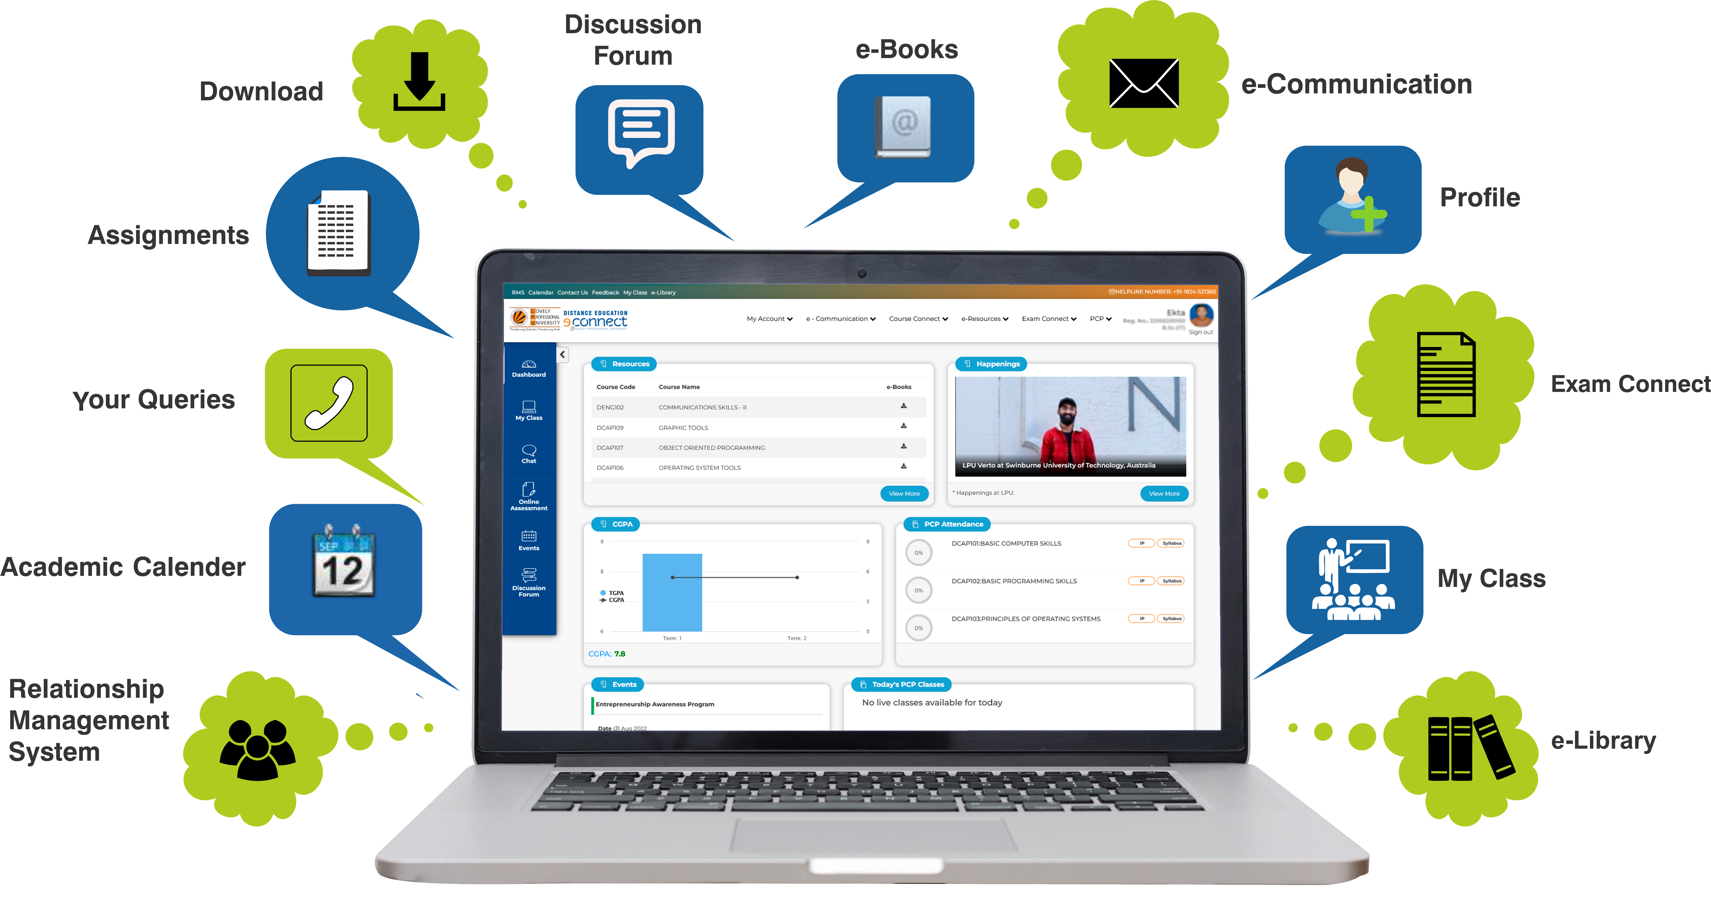
LPU e-Connect (Features/Key Modules)
Exam Connect: giving information regarding Assignment Submission, Date Sheet, Student Admit Card, Result, Grade Card and other forms etc. available thereto.

Slide 6
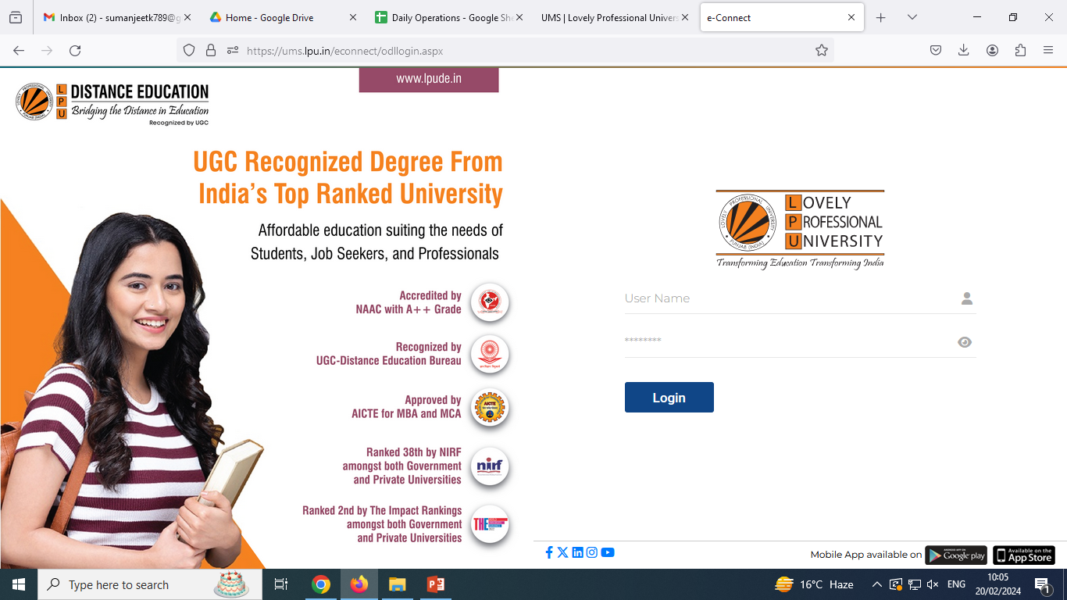
Log in to LPU e-Connect
Log in Using: User Name and Password provided by University
Username: “Registration No.”
“Credentials to be shared by University with all; subject to fulfilment of eligibility criteria and completion of admission process.”
How to Login

Slide 7
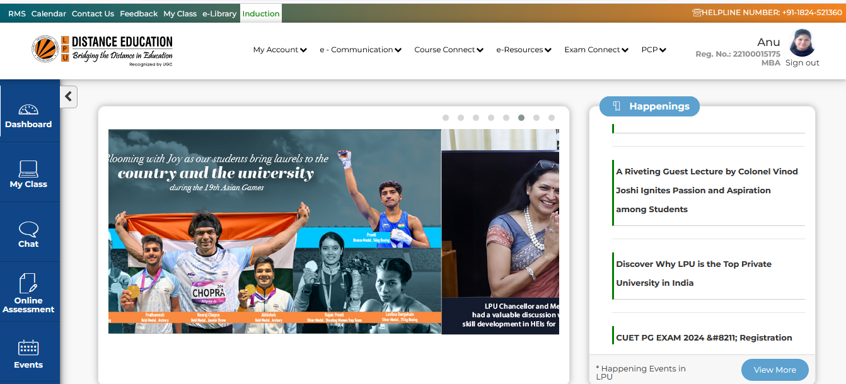
Dashboard with quick Links
Dashboard (After Login)
Path: LPU e-Connect Login --- > Dashboard

Slide 8
Dashboard with quick Links
Middle Section:
Happenings
Resources
CGPA
PCP Attendance
Events
Today’s PCP Classes
Pending Assignments
My Messages
Recently Placed (Regular)
Today’s Placement Drives (Regular)
Announcements
Left Side Quick Links:
Dashboard
My Class
Chat
Online Assessment
Event

Slide 9
Left Side Quick Links:
Dashboard
My Class
Chat
Online Assessment
Events

Slide 10
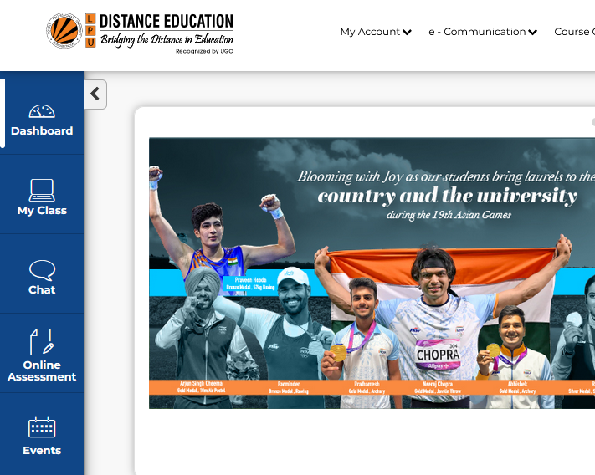
Left Side: My Class
My Class
Navigation: Dashboard>> My Class
Or
Direct Link: https://myclass.lpu.in/
(Log in with same username and password of LPU e-Connect)
Access of My Class platform to be activated for conducting any PCP Classes/ Online workshops/ special classes for registered students.
Schedule of online/ offline classes to be shared on LPU e-Connect under “Today’s PCP Classes” section of Dashboard.
Link to access My Class (Live class)

Slide 11
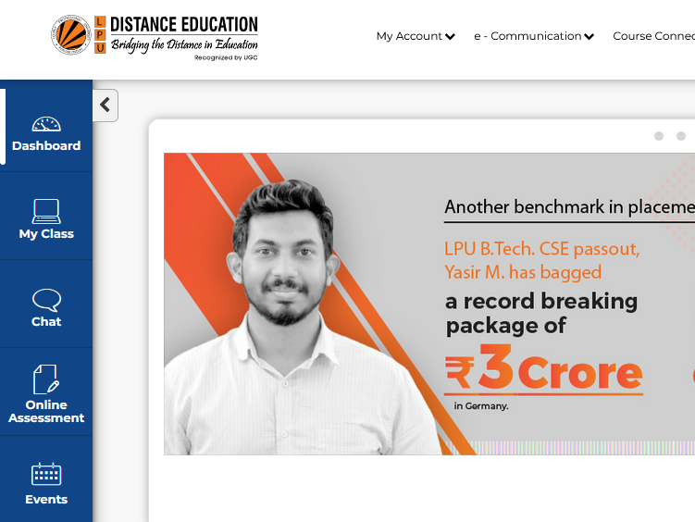
Left Side: Chat (LPU Live)
Chat (LPU Live)
Navigation: Dashboard>> Chat
Or
Direct Link: https://lpulive.lpu.in/
(Log in with same username and password of LPU e-Connect)
Student can interact with fellow students and with faculty on the basis of allotted sections. The Platform allows users to share all type of files (pdf, images, audio, video etc).
Note: Platform to be used for academic interactions only during PCP classes.
Link to access LPU Live chat

Slide 12
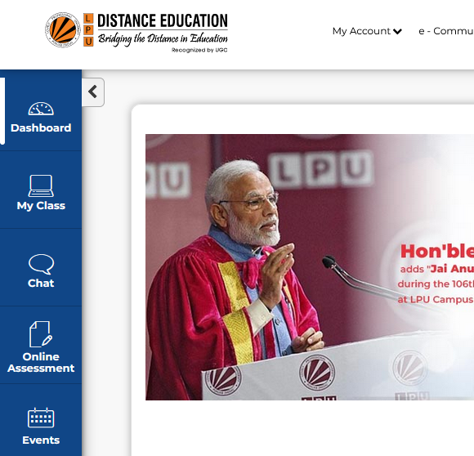
Left Side: Online Assessment
Online Assessment
Navigation: Dashboard >> Online Assessment
Or
Direct Link: https://oas.lpu.in
(Log in with same username and password of LPU e-Connect)
Online Assessment System (OAS): An Online platform to conduct various kind online tests using specially designed question pool incorporated automated designing of test with auto calculation of result.
Link to Online Assessment

Slide 13
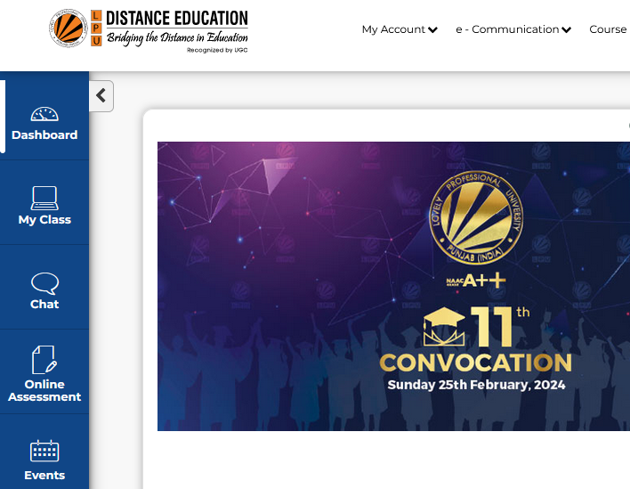
Left Side: Event
Event:
Navigation: Dashboard>> Event
Or
Direct Link: https://www.lpude.in/academics/workshop-seminar.aspx
Provides the information and provision to register for participating various events/ workshops being organized by University from time to time
Link to view and register for Events

Slide 14
Middle Section:
Happenings
Resources
CGPA
PCP Attendance
Events
Today's PCP Classes(Time Table, Attendance)
Pending Assignments
My Messages
Recently Placed (Regular)
Today’s Placement Drives (Regular)
Announcements

Slide 15
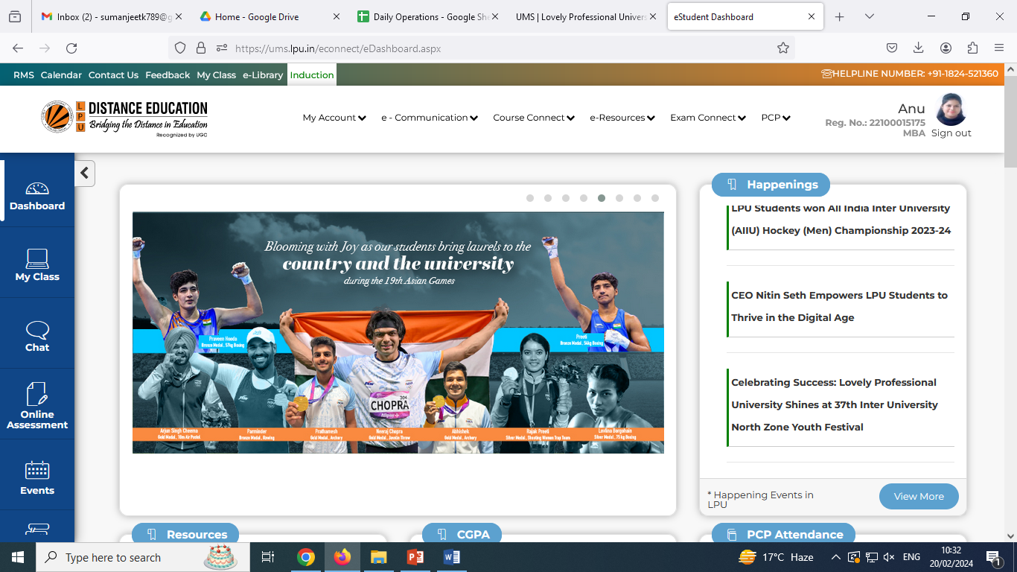
Happenings
Navigation: Dashboard >> Happenings
Happenings: provides easy access to view the updates related to current activities happening in the university.
View More: directs to the web page providing access happenings in the university.

Slide 16
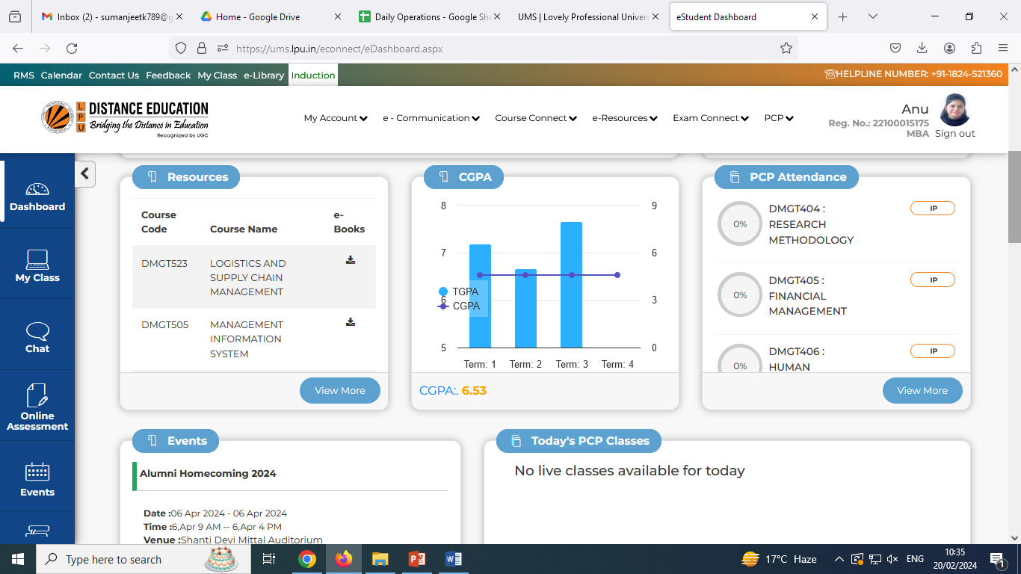
Resources
Navigation: Dashboard >> Resources
Or
E-Resources >> Academic
Resources: provides easy access to download course wise e-Books on a click
View More: directs to the interface providing access for Programme Guide, e-Books, Previous Year Question Papers etc.

Slide 17
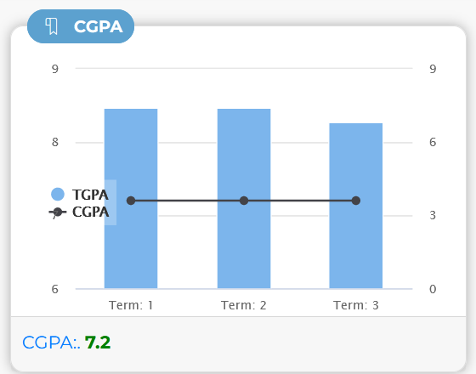
CGPA
CGPA
Navigation: Dashboard >> CGPA
Or
Exam Connect >> View Marks/ View Grades
provides the complete information about the CGPA and TGPA of each Term on the Dashboard
provides quick access to view result.

Slide 18
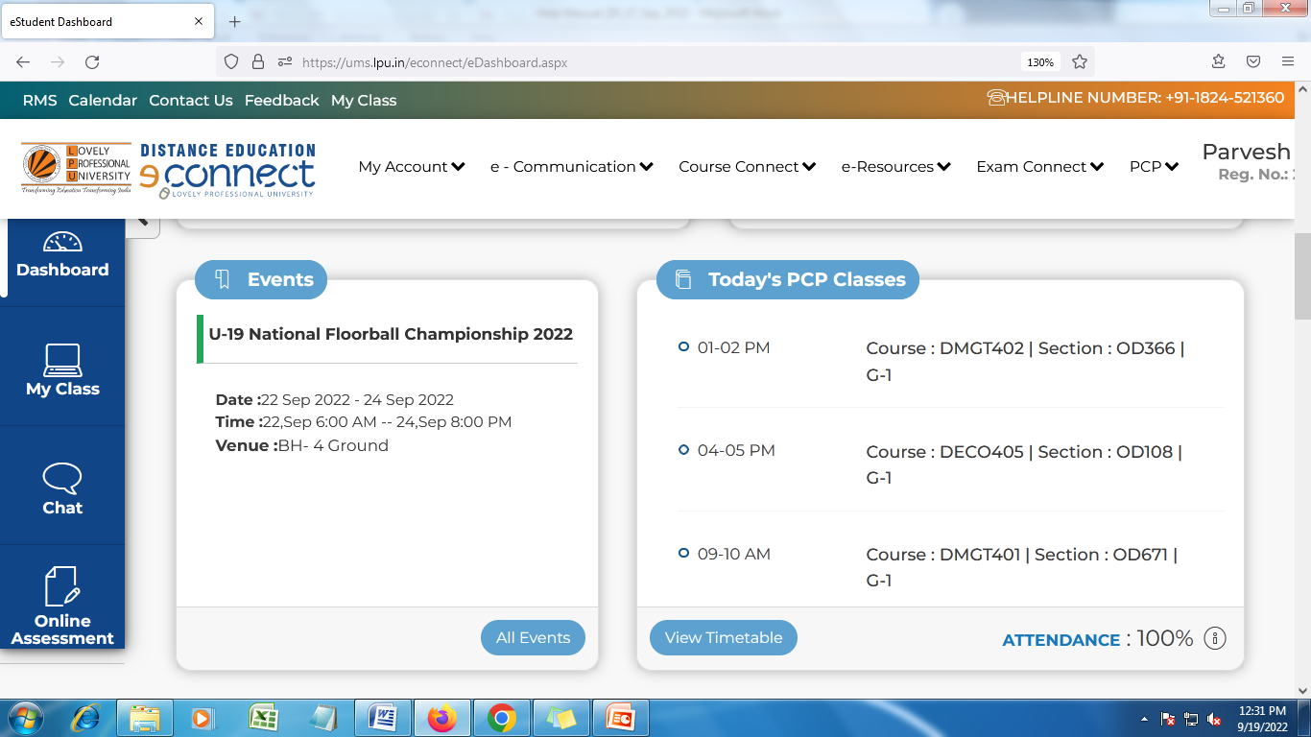
Today’s PCP Classes
Navigation: Dashboard>> Today’s PCP Classes
It provides information regarding classes scheduled for the day and access to weekly timetable
%age of Overall attendance in lectures

Slide 19
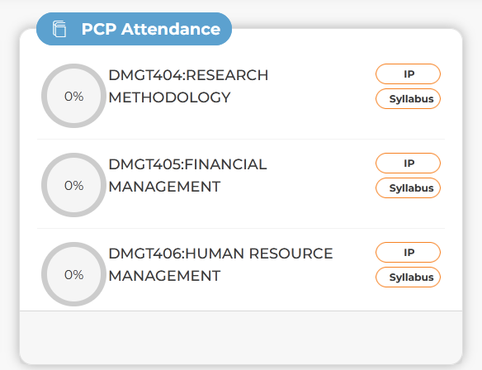
PCP Attendance
PCP Attendance
Navigation: Dashboard >>PCP Attendance
Or
PCP >> View Attendance
Displays the attendance of PCP Classes in percentage.
Also, student can view the Syllabus

Slide 20
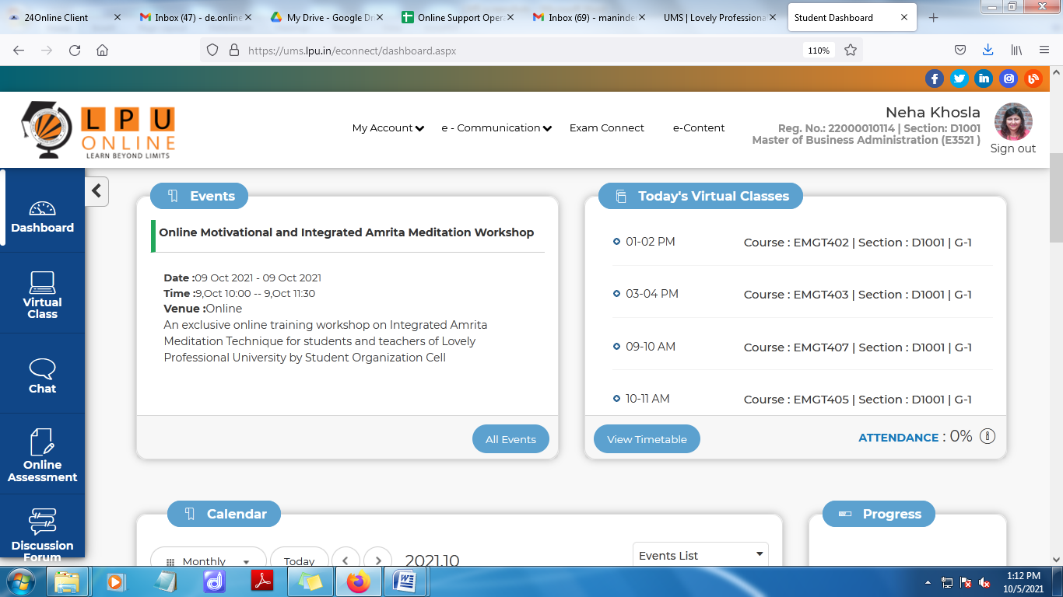
Events at LPU
Navigation: Dashboard>> Events
Provides information of all the upcoming Events expected to happen at University and gives equal opportunity to all the students to participate.

Slide 21
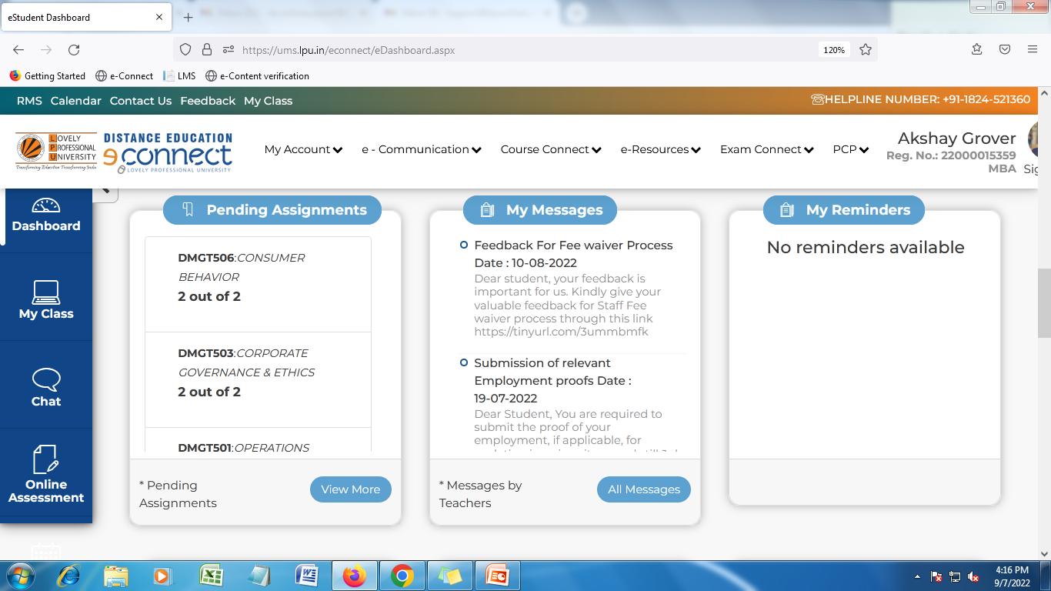
Pending Assignments
Pending Assignments
Navigation: Dashboard >> Pending Assignments
Or
Exam Connect >> CA Submission
This Section includes the course wise Assignments.
“View More” section displays the Course wise Assignments including the Term Id, Start Date, End Date, Total Marks of each Assignment.

Slide 22
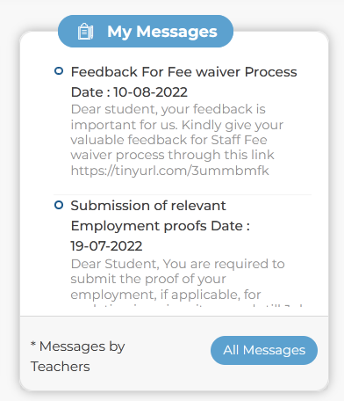
My Messages
Navigation: Dashboard>> My Messages
Or
Dashboard >> e-Communication >> Messages
To facilitate the user to view personalized messages posted by university related to Academics, Examinations and other
All the Messages on a click will be available to view through “ All Messages”

Slide 23
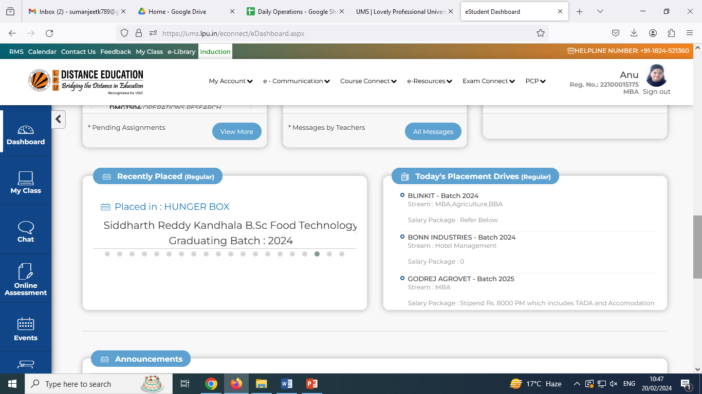
Recently Placed and Today’s Placement Drives
Navigation: Dashboard>> Recently Placed (Regular)
This section facilitates the user to view the details of Recently Placed students from Regular Mode.
Navigation: Dashboard>> Today’s Placement Drives (Regular)
This section facilitates the user to view the updates related to Placement Drives to be conducted on a particular day for Regular Mode students.

Slide 24
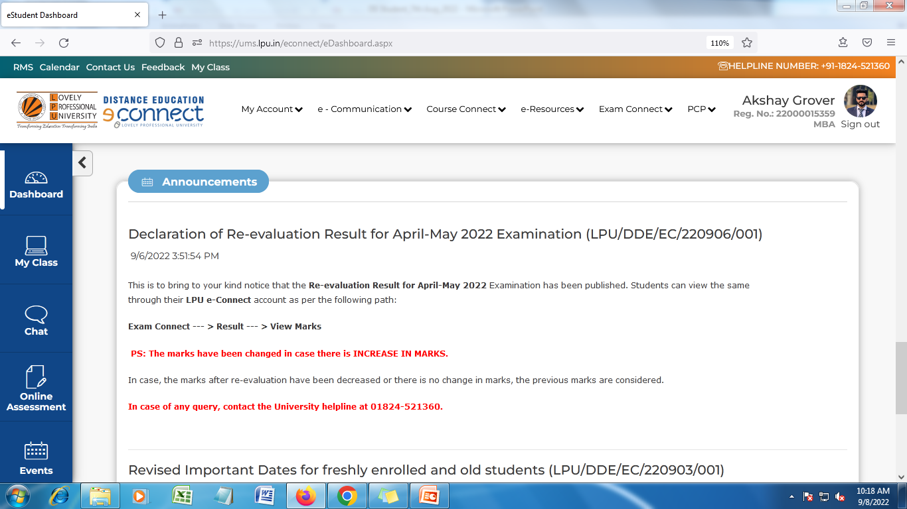
Announcements
Navigation: Dashboard >>Announcements
This section reflects all the Announcements related to Academics, Examination, Placements etc. posted by the University.

Slide 25
Main Menu

Slide 26
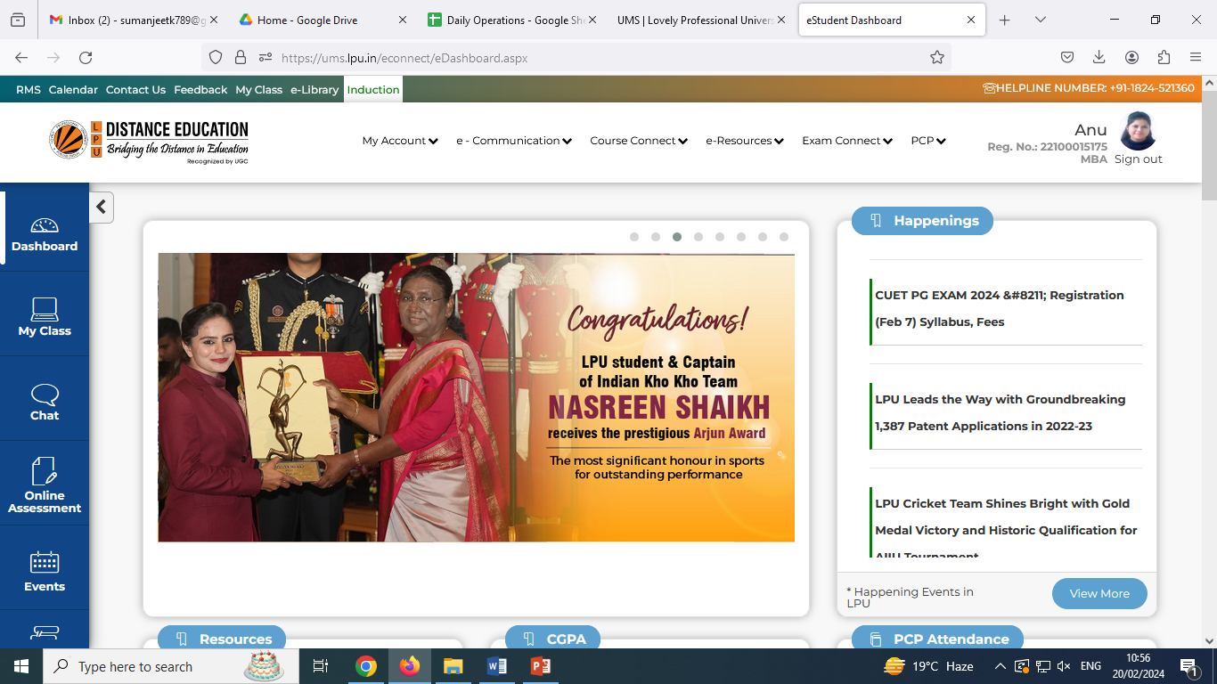
LPU e-Connect: Main Menu
Menu: Menu available on Dashboard provides easy access to various interfaces
Main Menu on Top:
My Account
Course Connect
E-Resources
Exam Connect
PCP
Quick Information
Profile Photo
Registration No.
Programme
Help Manual
Provision to Change Password
My Profile

Slide 27
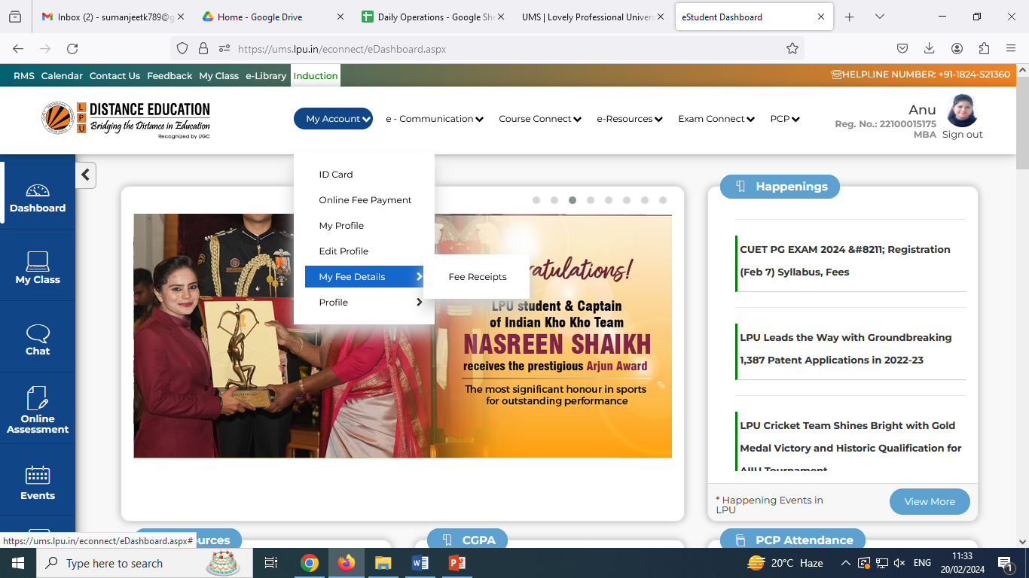
LPU e-Connect: My Account
My Account: "My Account" is a personalized account of the user containing maximum details related to the user and his account. User can view and edit his/ her profile.
ID Card
Online Fee Payment
My Profile
d. Edit Profile
e. My Fee Details
i. Fee Receipts

Slide 28
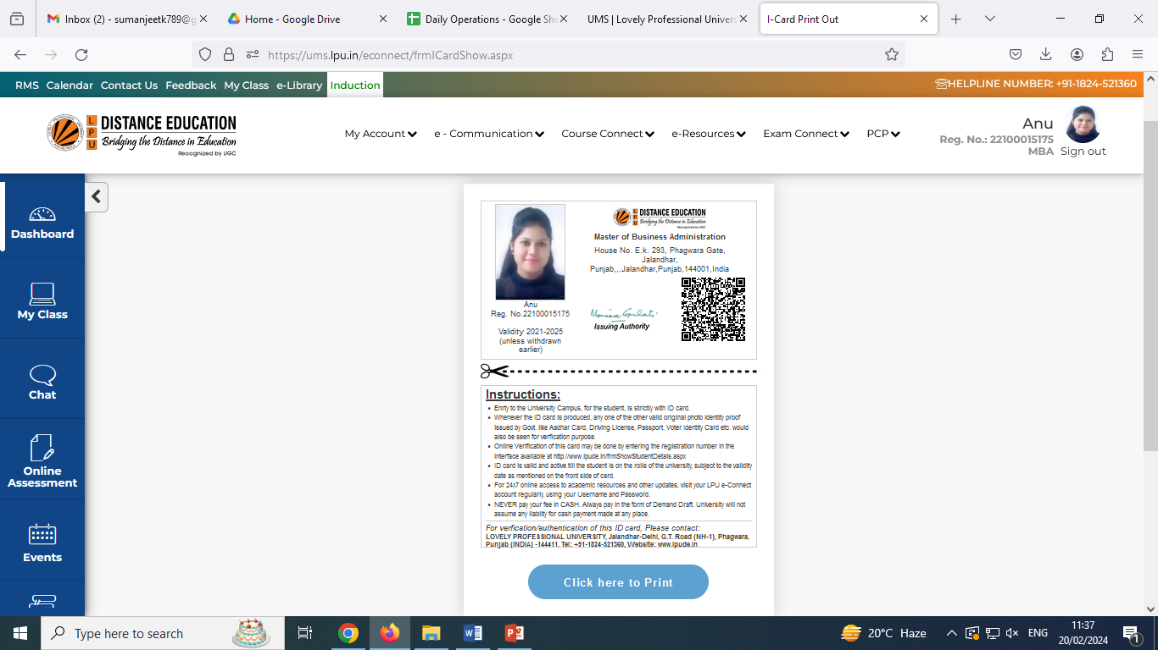
LPU e-Connect: My Account
a. ID Card
Navigation: Dashboard>> My Account >> ID card
Student can also print the ID card, Printing is limited to 3 attempts

Slide 29
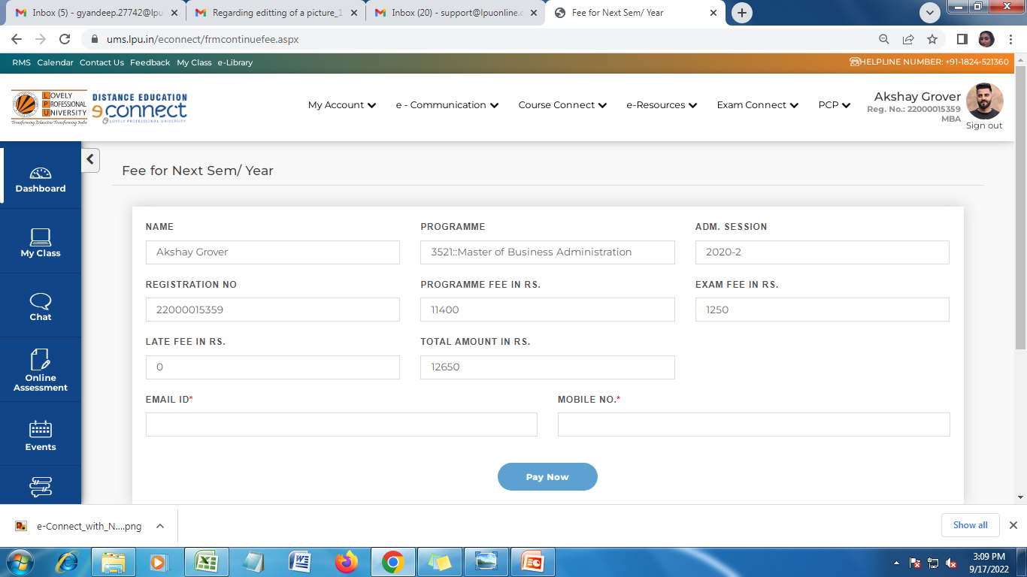
LPU e-Connect: My Account
b. Online Fee Payment
Navigation: Dashboard>> My Account >> Online Fee Payment
Online fee payment for next semester to get yourself registered; wait for 2 hours to reattempt if status not updated to avoid double payments
All details are auto filled
Fill email ID and Phone No.
Click to pay fee

Slide 30
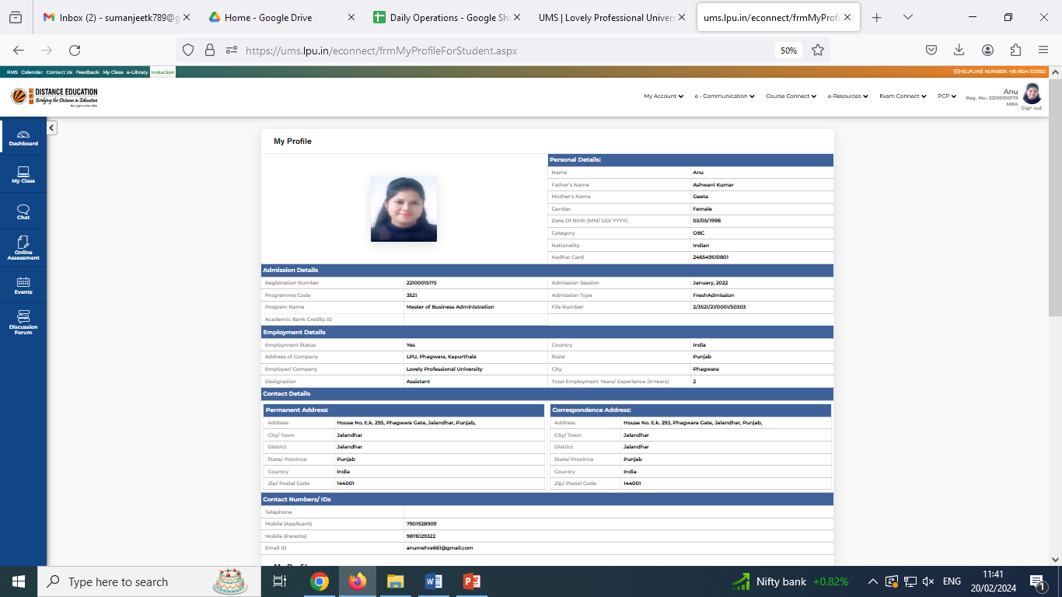
LPU e-Connect: My Account
c. My Profile
Navigation: Dashboard>> My Account >> My Profile
Personalized account of student containing information related to his/her personal and academic details.

Slide 31
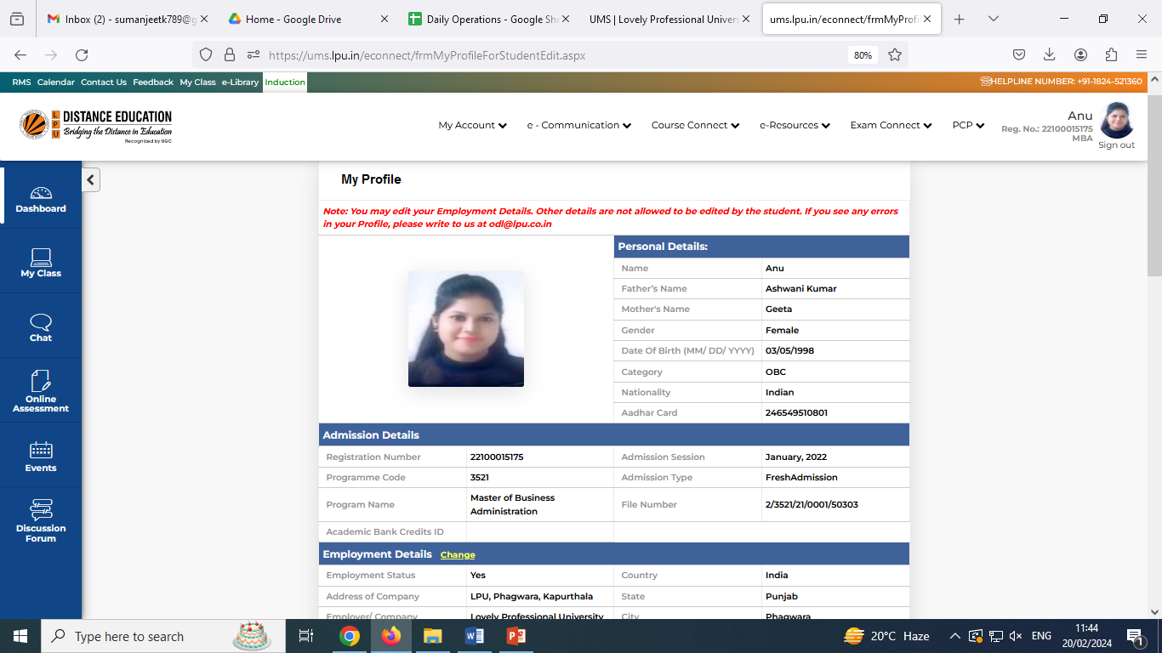
LPU e-Connect: My Account
d. Edit Profile
Navigation: Dashboard>> My Account >> Edit Profile
To provide the facility for updating some of personal and other details (Updated employment details)

Slide 32
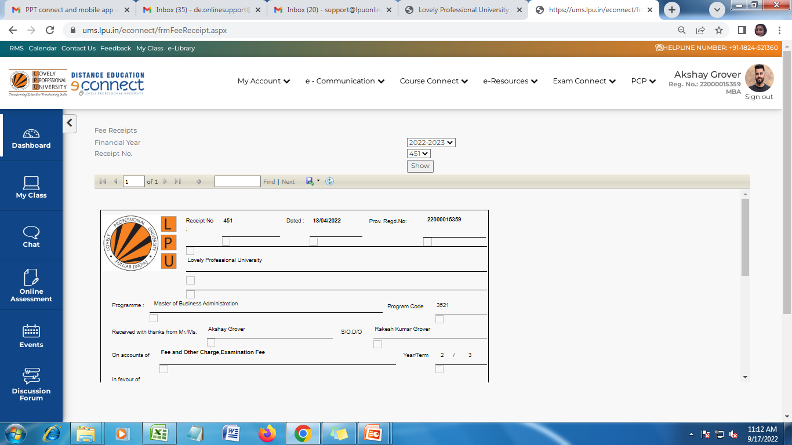
LPU e-Connect: My Account
e. My Fee Details
Navigation: Dashboard>> My Account >> My Fee Details>>Fee Receipt
View fee receipt once the fee is received by University and updated after verification
Select “Financial Year”
Select Receipt No. From the dropdown
Click on “Show” to view fee receipt

Slide 33
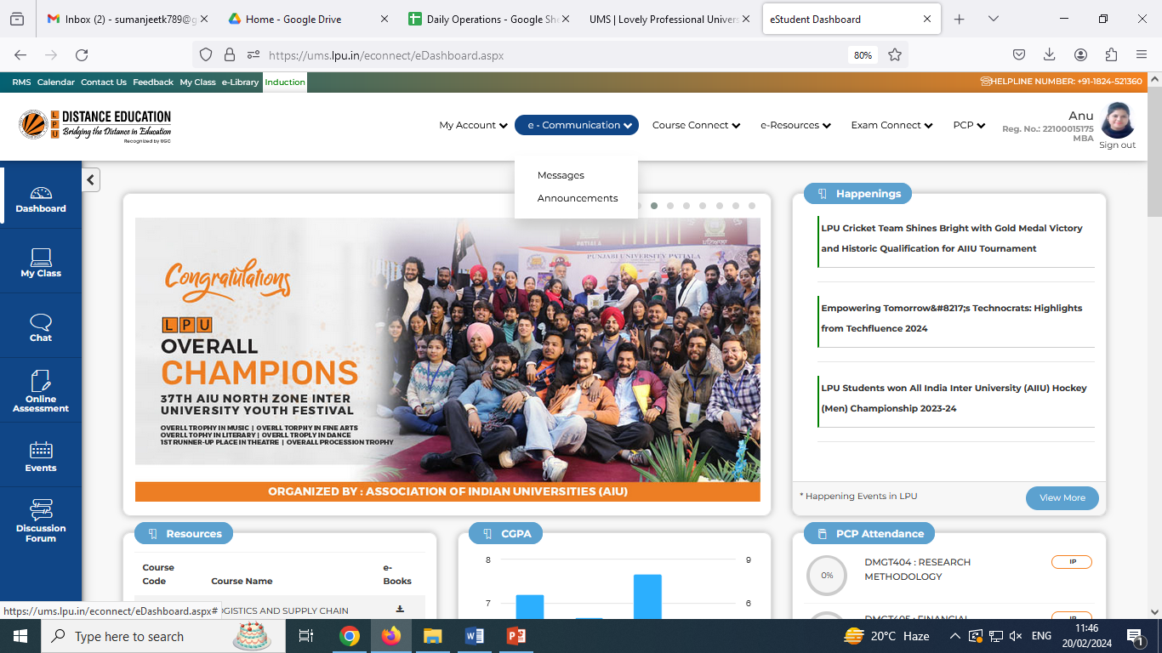
LPU e-Connect: e-Communication
e- Communication: To facilitate the user to view all personalized “Messages” and “Reminders” posted by university related to various day to day activities related to academics, examinations and other categories
Note: all communications by University will be done through LPU e-Connect only
Messages
Announcements

Slide 34
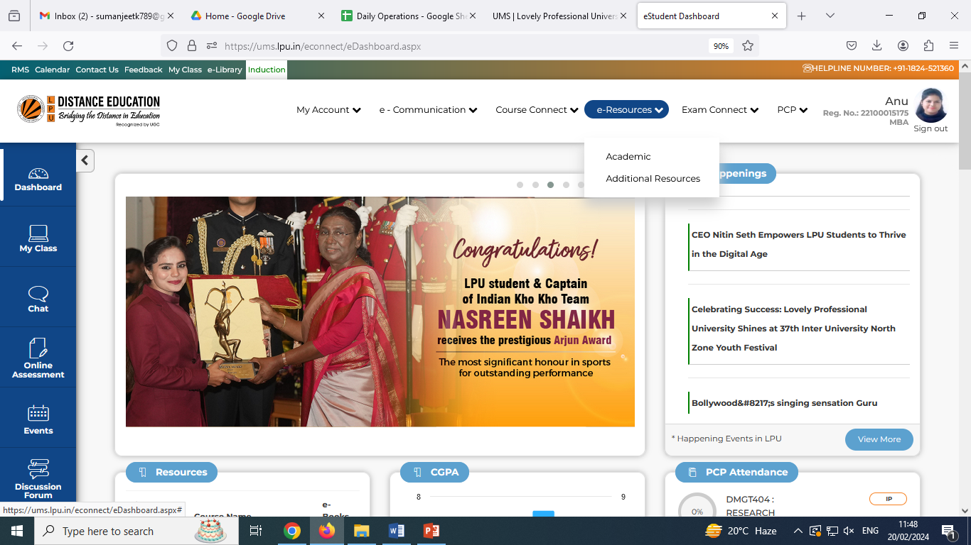
LPU e-Connect: Course Connect
Course Connect: giving information on registered courses under “My Courses” section and facilitates students to submit online request to change of specialization/ electives etc. as applicable and timelines announced by University.
My Courses,
Course Change Request

Slide 35
LPU e-Connect: e-Resources
Navigation : Main Menu >> e-Resources
Provides easy access to various “Academic” and “Additional Resources”.

Slide 36
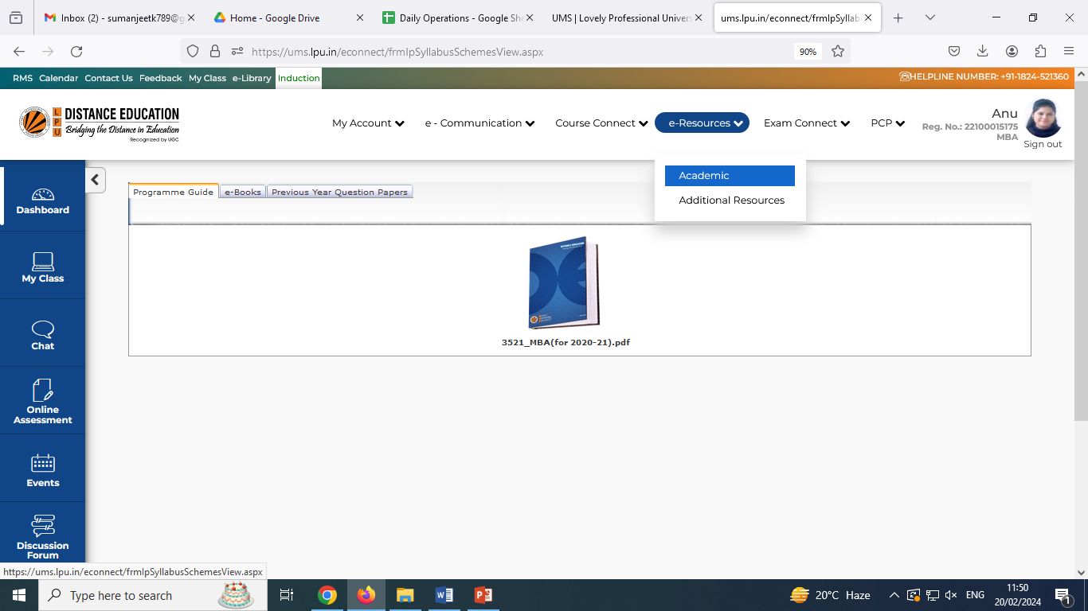
e-Resources: Academic
Navigation : Main Menu >> e-Resources >> Academic
Access to Academic resources like “Programme Guide”, “e-Books” and “Previous Year Question Papers” as per the registered programme.
e-Books: availability of course and term wise soft copies of Self Learning Material (SLM) to make the learning easier for all the students. Promoting Eco friendly system by increasing use of e-books over printed books

Slide 37
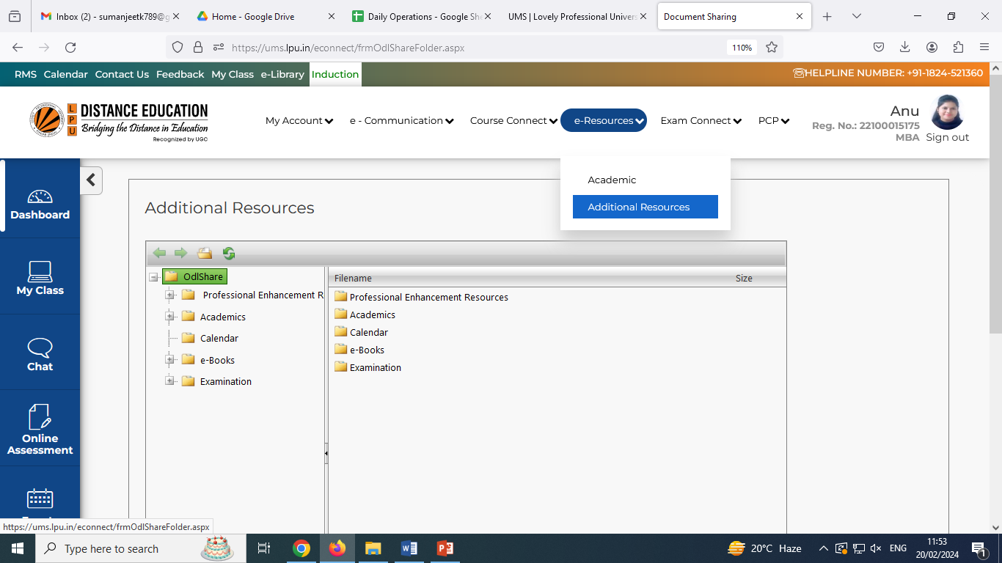
e-Resources: Additional Resources
Navigation : Main Menu >> e-Resources >> Additional Resources
Open folder to access all academic and administrative resources not limiting to the registered programmes. Its a pool of all type of resources applicable to all domains/ disciplines. No restriction to access this section.

Slide 38
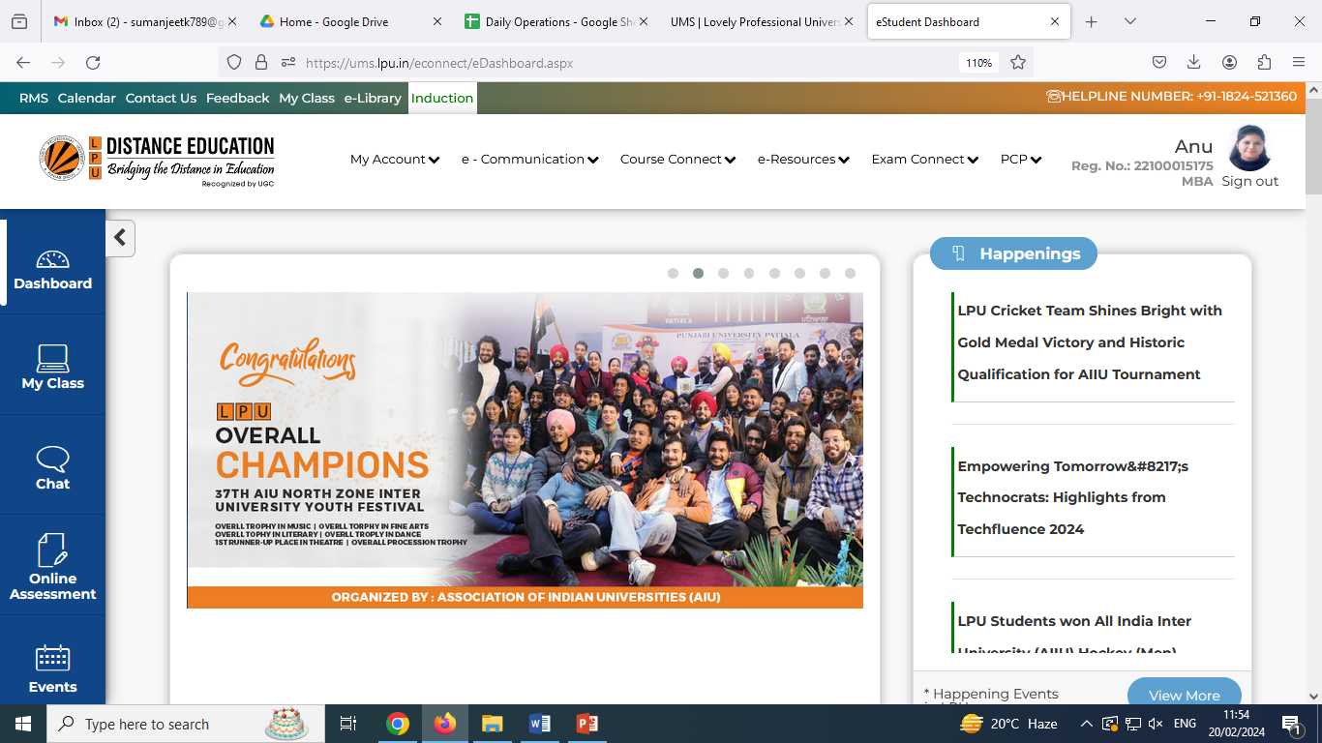
LPU e-Connect: Exam Connect
Exam Connect: To provide easy access to resources and information related to Examination and Result e.g. Date Sheet, Admit Card, Assignment Submission, Result, Re-appear Registration etc.
CA Submission (Assignments)
Datasheet
Download Admit Card
Result
View Marks
View Grades
Writer Request
Practical Report/ CDP/ Term Paper/ Summer Training Project etc. Submission
Exam Registration (Re-registration/ Re-evaluation Registration)
Provisional Academic Transcript
Certificate Request

Slide 39
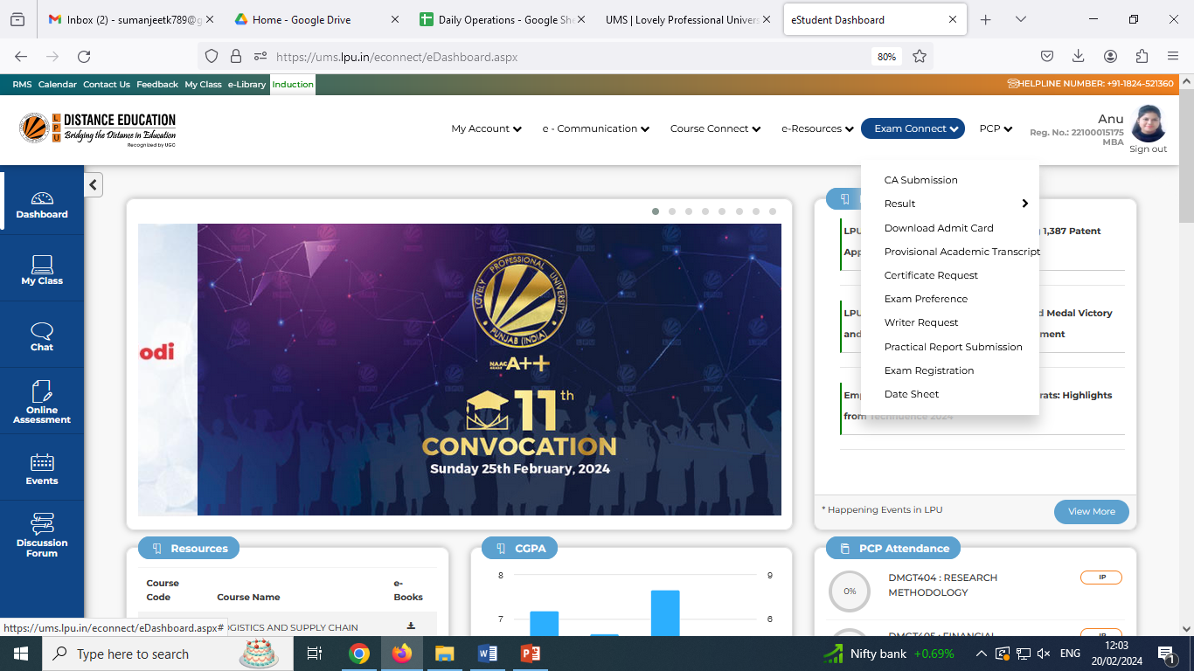
LPU e-Connect: Exam Connect
Exam Connect: The most of interfaces under “Exam Connect” would be visible and accessible on or before the applicable timelines as announced by University or mentioned in the list of Important dates documents available under “Calendar” section.

Slide 40
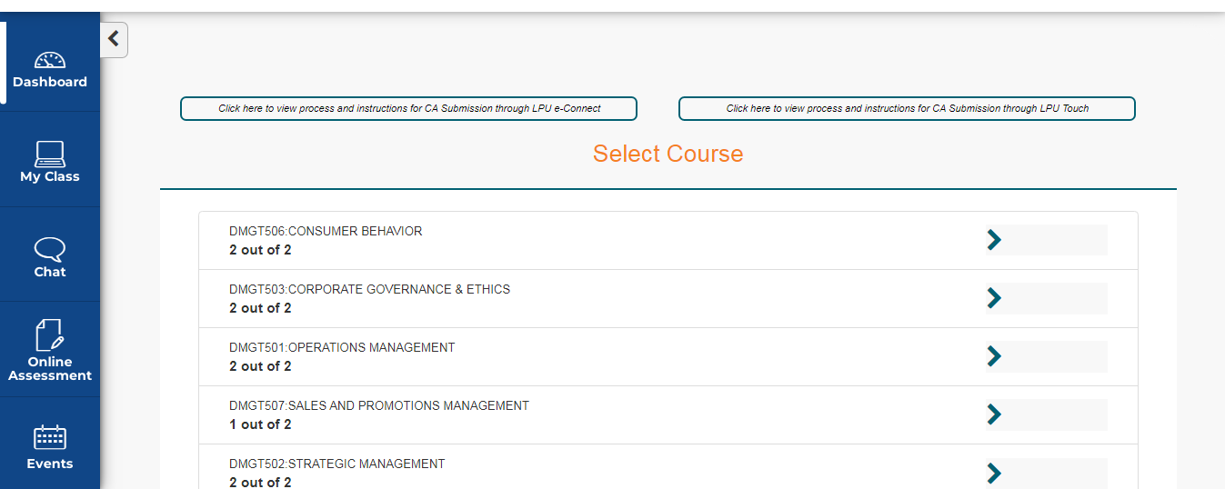
LPU e-Connect: Exam Connect
a. CA Submission (Assignment Submission)
Navigation: Dashboard >> Exam Connect >> CA Submission
Provision to download the assignments of all courses and to upload the hand written assignments in the form of Image by following the process prescribed by the university
Guidelines for uploading assignments through LPU e-Connect
Guidelines for uploading assignments through LPU Touch App
Course Name and Course Code
No. of assignments submitted by student
No. of Assignments to be submitted

Slide 41
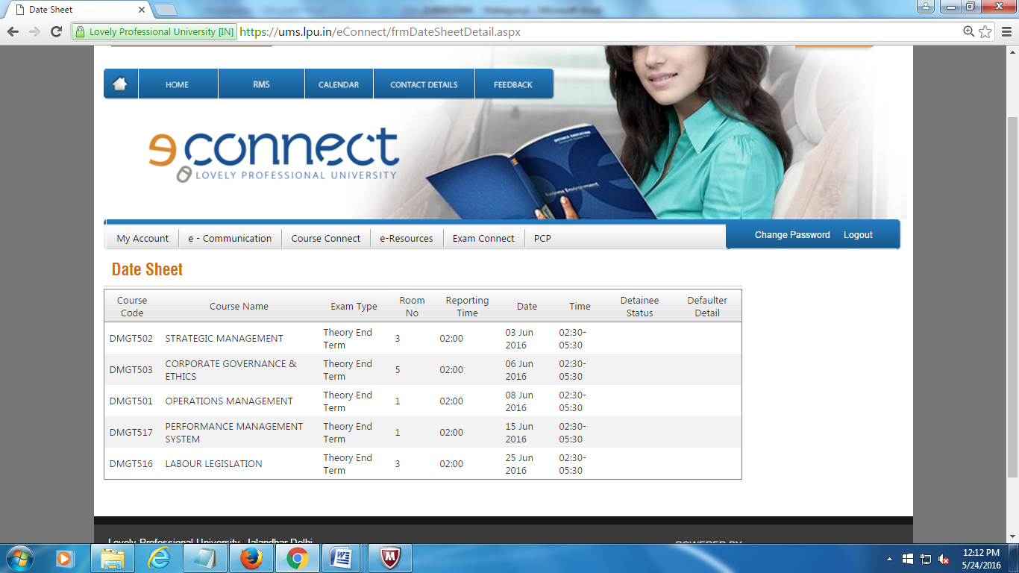
LPU e-Connect: Exam Connect
b. Date Sheet
Navigation: Dashboard >> Exam Connect >> Date Sheet
To provide easy access to Date Sheet of Examination

Slide 42
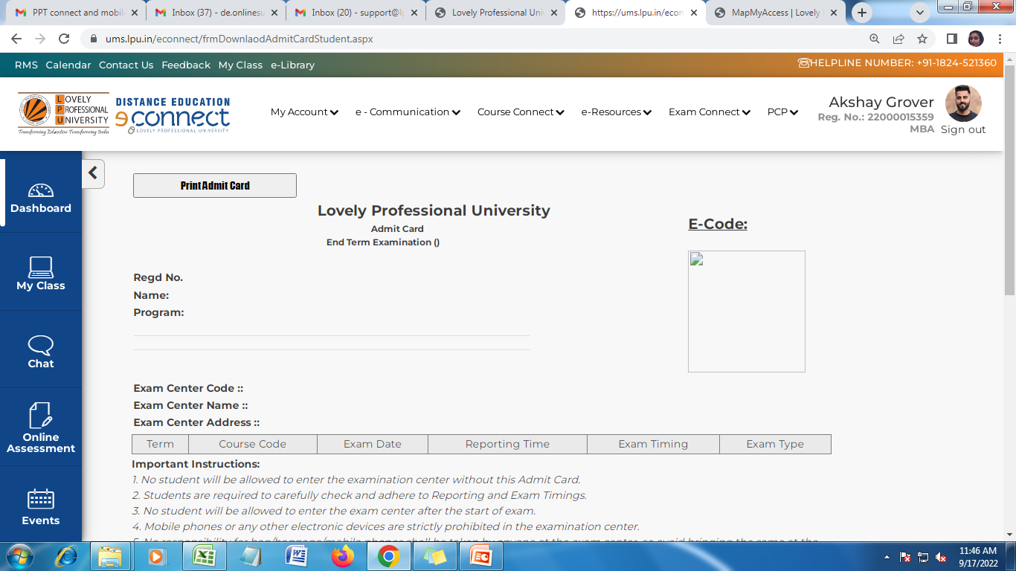
LPU e-Connect: Exam Connect
c. Download Admit Card
Navigation: Dashboard >> Exam Connect >> Download Admit Card
To download and print Admit Card by clicking on “Print Admit Card” with details of examination conduct

Slide 43
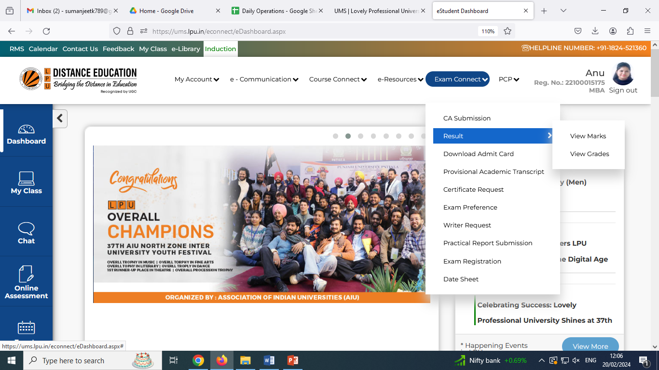
LPU e-Connect: Exam Connect
d. Result
Navigation: Dashboard >> Exam Connect >> Result
Provides the provision to view result in “Marks View” and “Grades View”

Slide 44
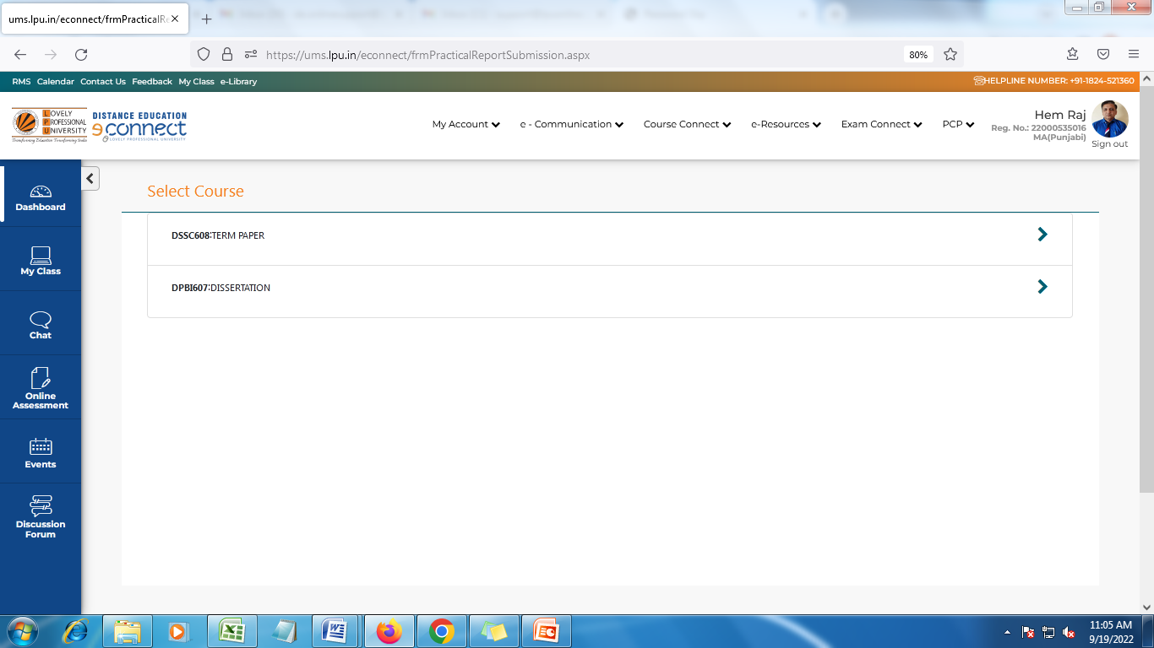
LPU e-Connect: Exam Connect
e. Practical Report/ CDP/ Term Paper/ Summer Training Project Submission
Navigation: Dashboard >> Exam Connect >> Practical Report Submission.
Interface to be opened as per the programme scheme only and access is provided to applicable students as per the timelines given by University
Select Course from the courses reflecting in “ Practical Report Submission
Click on “>” to view the applicable practical.
It will redirect to the Page where the details of Practical will be mentioned.

Slide 45
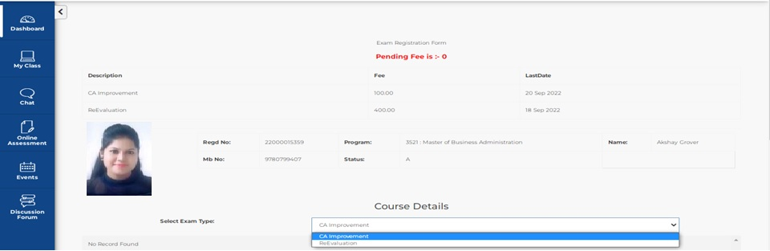
LPU e-Connect: Exam Connect
f. Exam Registration
Navigation: Dashboard >> Exam Connect >> Exam Registration
To provide the access to student to register for Re appear Examination/ Re-evaluation/ CA improvement etc. with online fee payment provision.

Slide 46
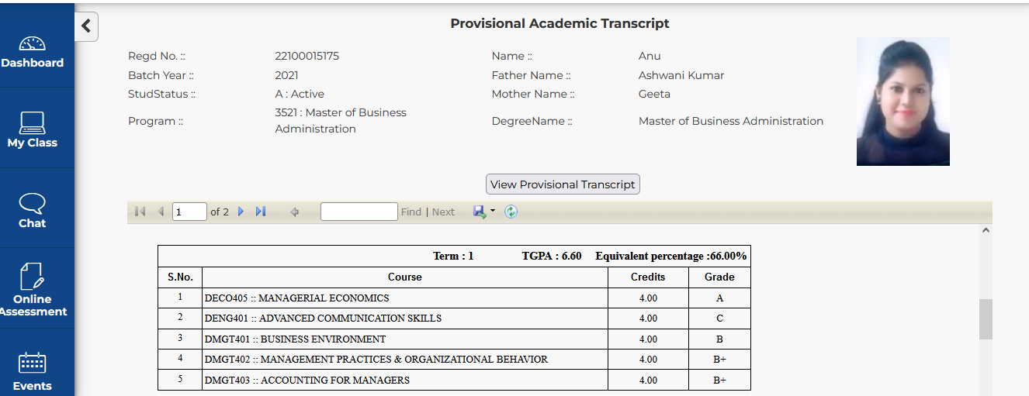
LPU e-Connect: Exam Connect
g. Provisional Academic Transcript
Navigation: Dashboard >> Exam Connect >> Provisional Academic Transcript
Provisional Academic Transcripts are provided online for quick access by the students .
Click to view Transcript
Can be downloaded

Slide 47
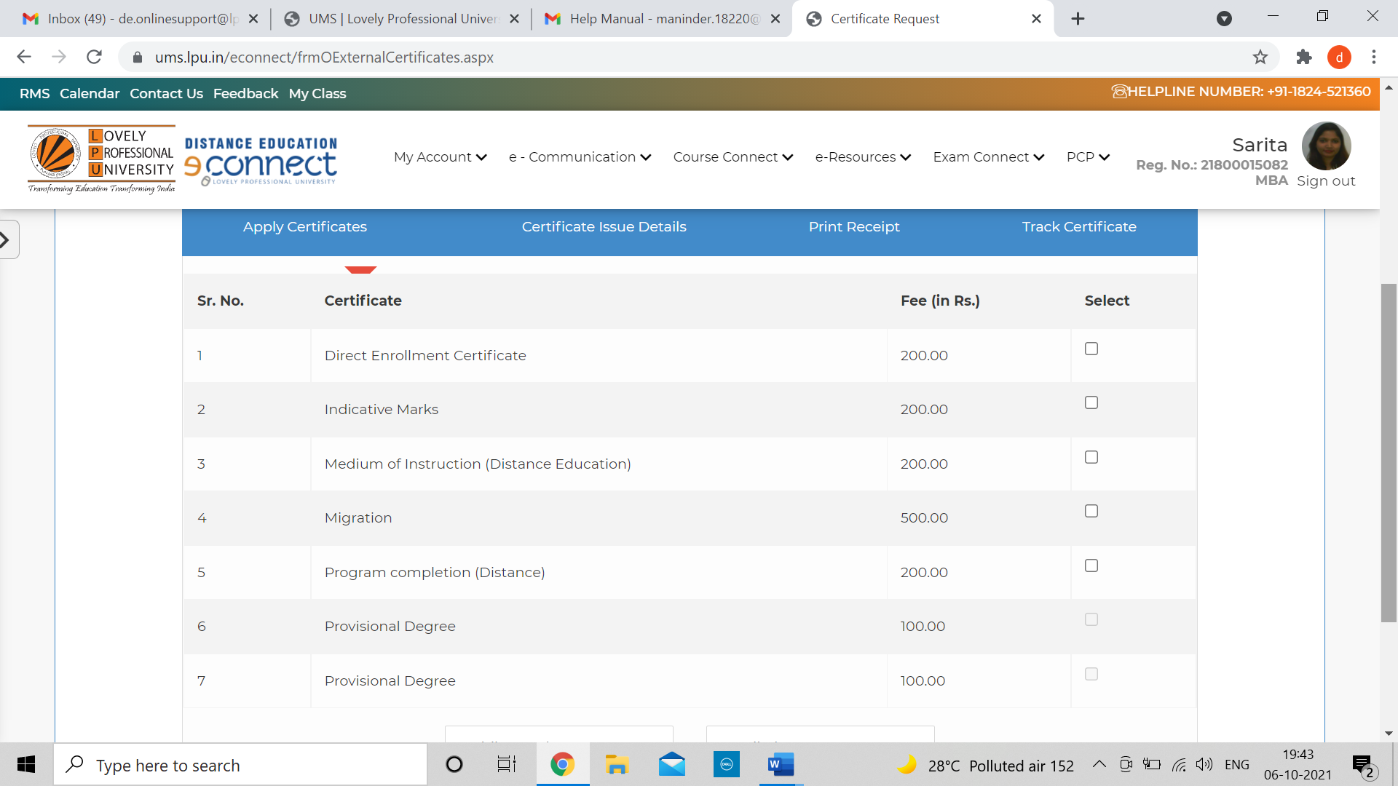
LPU e-Connect: Exam Connect
h. Certificate Request
Navigation: Dashboard >> Exam Connect >> Certificate Request.
Student can apply various certificates through online platform and by paying applicable fee though integrated online fee payment gateways. The status of certificate printing and dispatch can also be traced during the process.

Slide 48
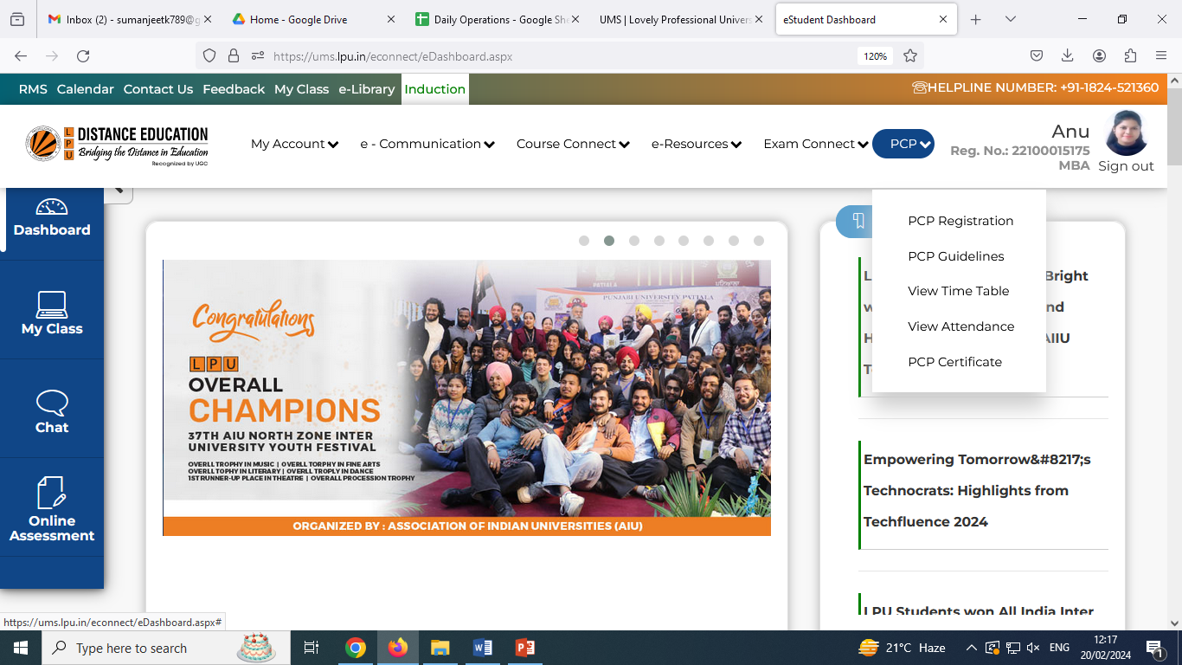
LPU e-Connect: PCP (Personal Contact Programme)
PCP: To provide facility of online registration for PCP (Personal Contact Program) at university campus.
PCP Registration
PCP Guidelines
View Time Table
View Attendance
PCP Certificates

Slide 49
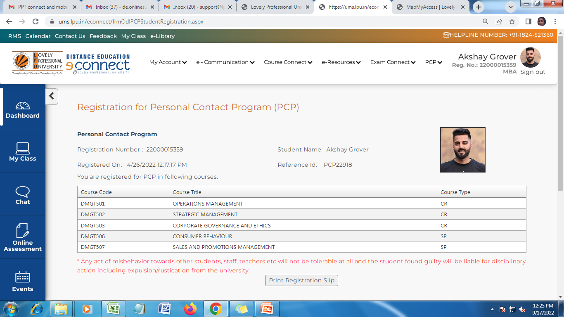

LPU e-Connect: PCP
a. PCP Registration
Navigation: Dashboard >> PCP>> PCP Registration
Reflects the complete list of Courses for which Registration has been done with details of Courses: Course Code, Course Title, Course Type.
Click to Print the Registration Slip

Slide 50
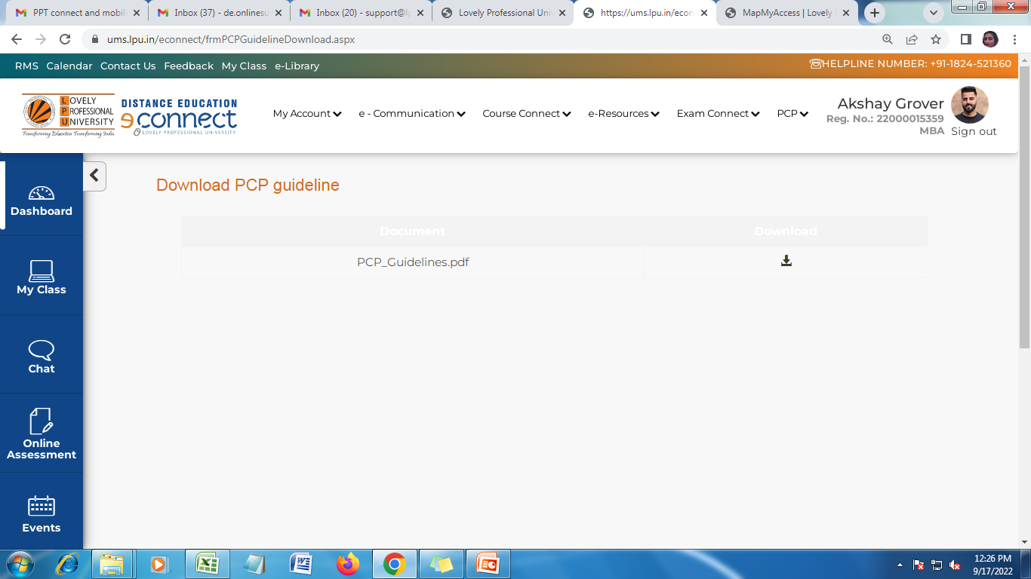
LPU e-Connect: PCP
b. PCP Guidelines
Navigation: Dashboard >> PCP>> PCP Guidelines
Click on given link to download the PCP Guidelines
Click here to download PCP Guidelines.
Step by step instructions and process have been mentioned to make the Registration process easy.

Slide 51
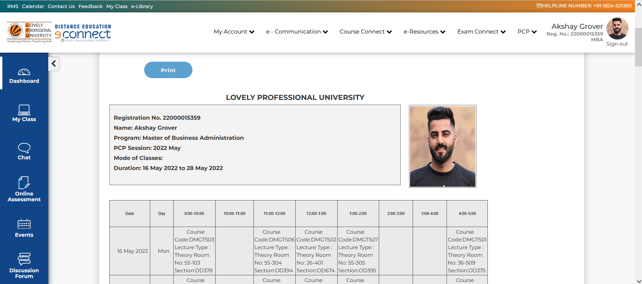
LPU e-Connect: PCP
c. View Time Table
Navigation: Dashboard >> PCP>> View Time Table.
Displays the complete Time Table with Course Code, Course Type, Course Title etc.
To provide date wise PCP Time Table to student as per registration done by him/her
Note: Attendance is Compulsory.

Slide 52
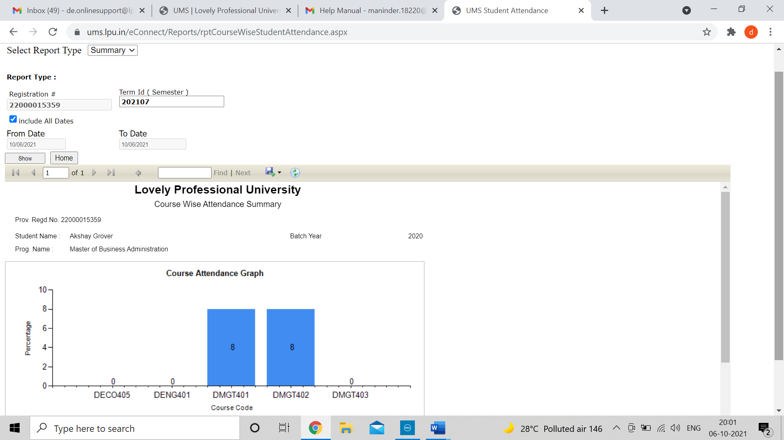
LPU e-Connect: PCP
d. View Attendance
Navigation: Dashboard >> PCP>> View Attendance
To provide the detailed and summarized report of PCP Attendance of the student
Note: Attendance is Compulsory.
Select the “Term Id”
Click on “Show” to view Attendance.
Provision to download the attendance

Slide 53
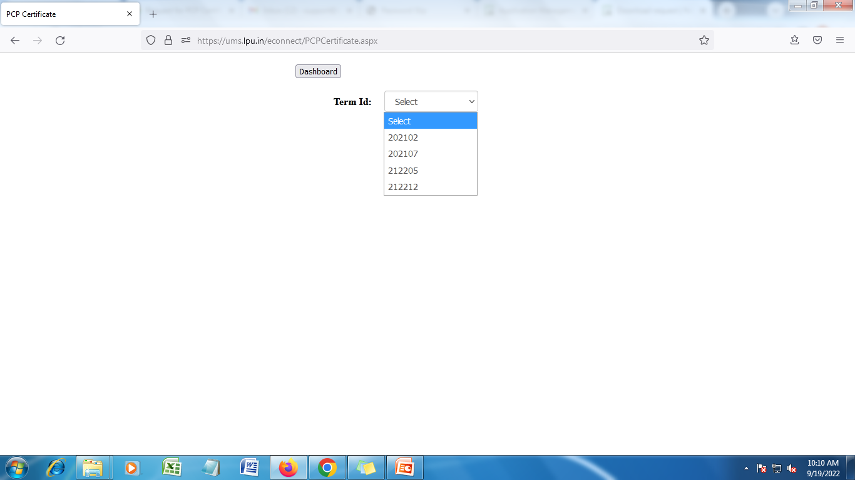
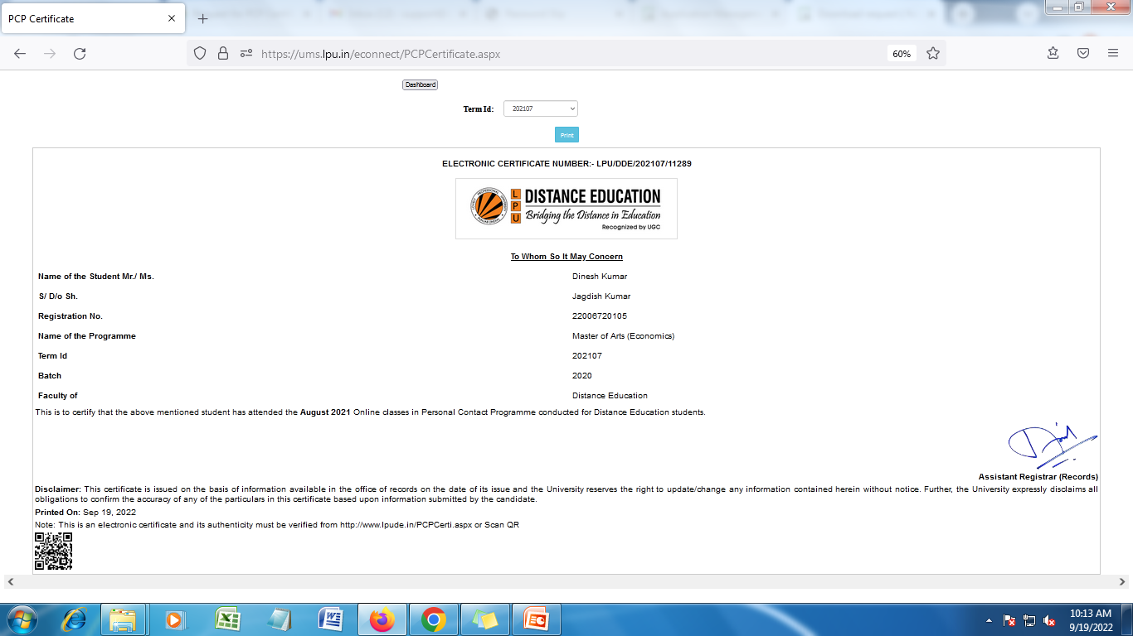
LPU e-Connect: PCP
e. PCP Certificate
Navigation: Dashboard >> PCP>> PCP Certificate
Note: Attendance is Compulsory.
Directs back to Dashboard
To view the certificate, select the Term ID from the Dropdown.
Certificates are made available on the basis of Attendance.
After selecting TERMID, PCP Certificate will reflect below the TERMID

Slide 54
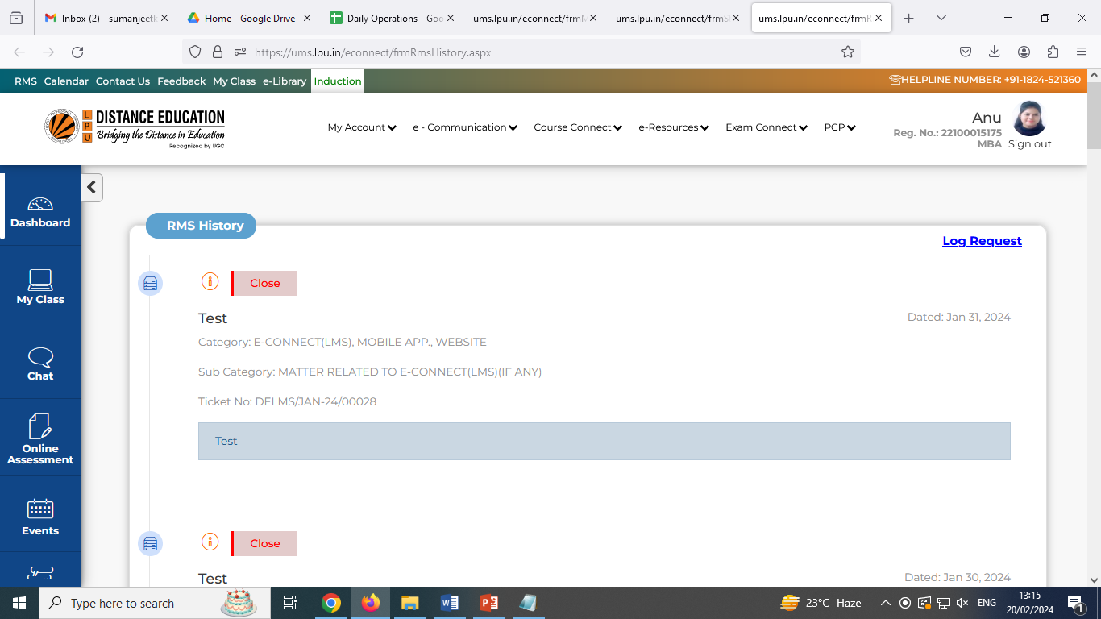
Relationship Management System
RMS: Provides easy access to place request through “Log Request” available in RMS interface.
Log Request: To raise new RMS request
History : To view history of submitted requests along with status

Slide 55
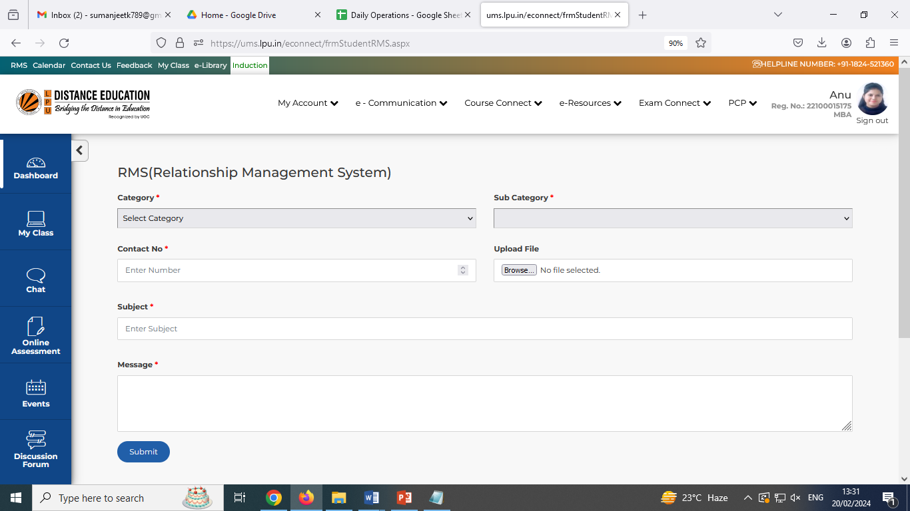
Relationship Management System
Log Request: To raise new RMS request following steps to be followed:
Select Category from available options
Select Sub Category
Enter Contact No.
Upload File (if applicable)
Enter the Subject of query
Enter the details of query
Click on “Submit”

Slide 56
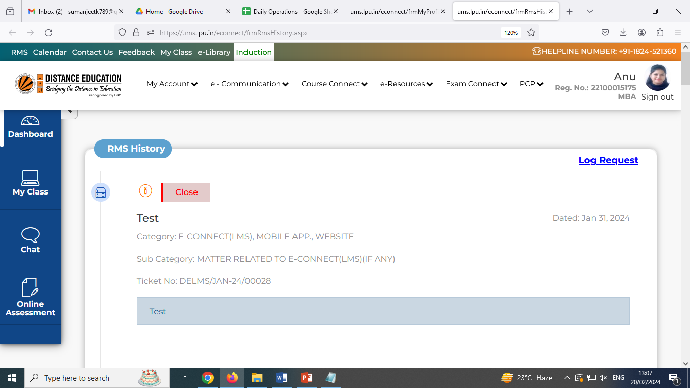
Relationship Management System
RMS History: To view the “History” of a particular RMS raised by you click on the icon as highlighted in the screenshot below:
Status of request can be checked through “RMS History”.
Click her to view the complete communication thread of an RMS.

Slide 57
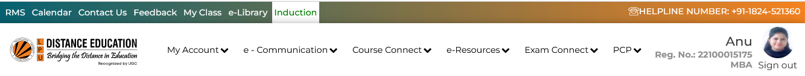
e-Library
e- Library: LPU e-Library System provides access to more than 20+ Lakh e-books covering all fields of knowledge. Providing access to variety of add on e-Resources, such as e-books, e-journals, e-newspapers, e-magazines etc.
Two ways to access “e-Library”:
Click on “e-Library” option available on Ribbon
URL: https://lpu.mapmyaccess.com/

Slide 58
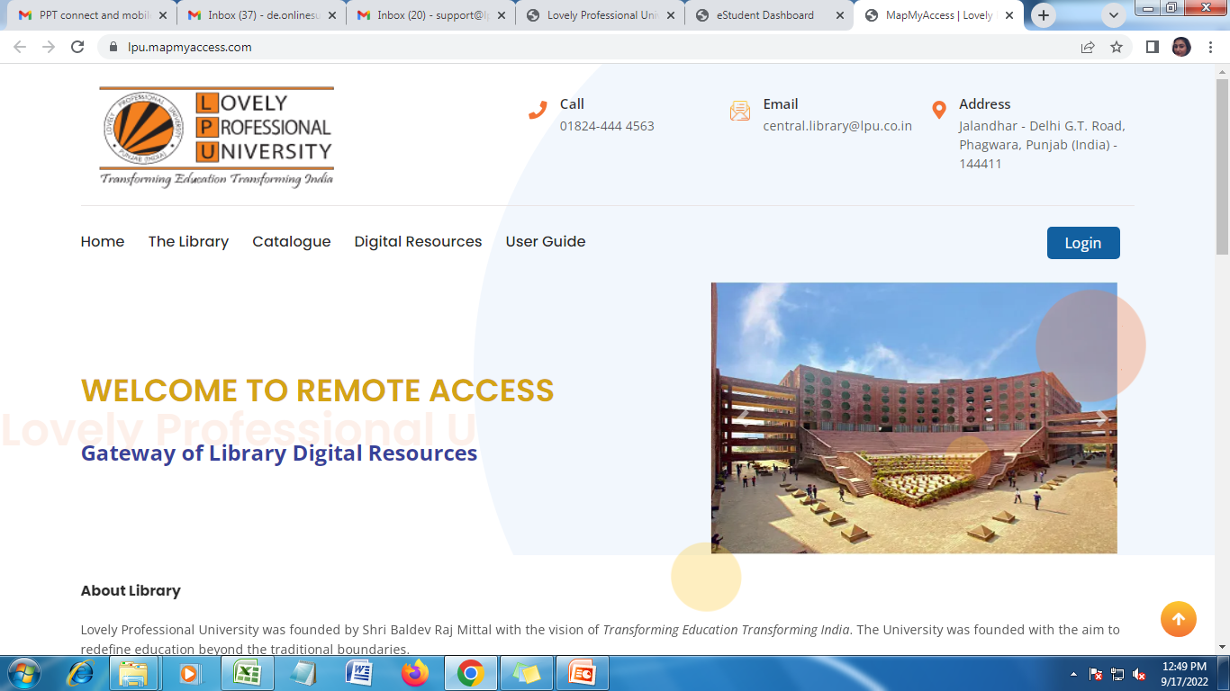
e-Library
Step-1: Click on “Login” to access the Login Page
URL: https://lpu.mapmyaccess.com/ will direct the user to the following WebPage.

Slide 59

e-Library
e- Library : Login Criteria
Step-2: Click here to view “Sign In(webservices)” box
Step-3: Login with credentials provided by the university (Same credentials of LPU e-Connect

Slide 60

Calendar
Provide quick access to download “List of Important Dates” and “List of Holidays”
Download all the required details through this “ Download” Button.

Slide 61

Contact US
Important contact details of University like email ID, Phone No. address etc. are provided on a click

Slide 62
Mobile App- LPU Touch
Play store: Android
Apple Store: IOS

Slide 63


LPU e-Connect: LPU Touch App
Android user to download app from pay store and IOS users to download app from Apple store by searching “LPU Touch” .
iPhone
Android

Slide 64


LPU e-Connect: Mobile App (LPU Touch)
The app is available and can be accessed by registered students by using username & password of LPU e-Connect .
iPhone
Android

Slide 65



LPU e-Connect: Mobile App
Dashboard
Side Panel
Student Profile
Resources
My Messages
Profile section includes “Basic” and “Academic Details”
Quick Links

Slide 66


LPU e-Connect: Mobile App
Side Panel; Provisions through Mobile App(LPU Touch)

Slide 67


LPU e-Connect: Mobile App
My Resources
Programme Guide
E-Books

Slide 68


LPU e-Connect: Mobile App
Announcements
Allows to search Announcement by “Date” as well as “Subject – Wise”.

Slide 69

LPU e-Connect: Mobile App
RMS Requests
This reflects All the RMS Requests.
Different tabs are available to view “Closed” and “Open” requests.

Slide 70



LPU e-Connect: Mobile App
Courses:
This section includes “Current Courses”, “Old Courses and “To be Registered Courses”.

Slide 71


LPU e-Connect: Mobile App
Result
View Marks
Select a Term ID to view the result of particular Term

Slide 72


LPU e-Connect: Mobile App
Fee Balance
Select a Financial Year in order to view the Fee Balance.
Fee Balance will reflect in this section with “Debit”, “Credit” and “Remarks”.

Slide 73

LPU e-Connect: Mobile App
Online Fee Payment
Navigation: Side Panel >> Online Fee Payment
All the details are prefilled.
Fill the “EMAIL ID” and “MOBILE NUMBER”
Click on “Pay Now”

Slide 74

LPU e-Connect: Mobile App
Admit Card
Navigation: Side Panel >> Admit Card
Admit Card is available before End Term Examination

Slide 75

LPU e-Connect: Mobile App
CA Submission
Navigation: Side Panel >> CA Submission
Process and Instructions to submit assignments through LPU Touch App
Process and Instructions to submit assignments through LPU e-Connect
Course Name and Course Code

Slide 76

LPU e-Connect: Mobile App
Chat
Navigation: Side Panel >> Chat
Chat option can be accessed by login using same credentials as per LPU e-Connect
This option is activated only during PCP Classes

Slide 77

LPU e-Connect: Mobile App
e-Library
Navigation: Side Panel >> e-Library
Click on “UMS Credentials, enter same Username and Password for LPU e-Connect to access e-Library

Slide 78


LPU e-Connect: Mobile App
Fee Receipt
Navigation: Side Panel >> Fee Receipt
Select a Financial Year and Receipt No. in order to view the Fee Receipt
Fee Receipt will be reflected for selected options

Slide 79


LPU e-Connect: Mobile App
Feedback
Navigation: Side Panel >> Feedback
Select Category against which Feedback is to be submitted
Feedback can be given by selecting Rating against each parameter

Slide 80

LPU e-Connect: Mobile App (Side Panel)
Holiday List
Navigation: Side Panel >> Holiday List

Slide 81

LPU e-Connect: Mobile App (Side Panel)
Important Dates
Navigation: Side Panel >> Important Dates

Slide 82

LPU e-Connect: Mobile App (Side Panel)
Important Dates
Navigation: Side Panel >> Messages
Messages can be accessed either through “Notifications” option on dashboard or through “Messages” option available in menu

Slide 83

LPU e-Connect: Mobile App (Side Panel)
PCP
Navigation: Side Panel >> PCP Registration, PCP Attendance, PCP Guidelines, PCP Certificate, PCP Time Table
PCP related interfaces can be accessed through side panel options of each interface

Slide 84

LPU e-Connect: Mobile APP (Side Panel)
View Grades
Navigation: Side Panel >> View Grades
Term Wise Grade details can be accessed through “View Grades” option in Side Panel

Slide 85

LPU e-Connect: Mobile APP (Side Panel)
University Contact Details
Navigation: Side Panel >> University Contact Details
Postal Details and Other Contact details here.
Provision to access all the required contact details all at one place.

Slide 86
Thank you

