Slide 1


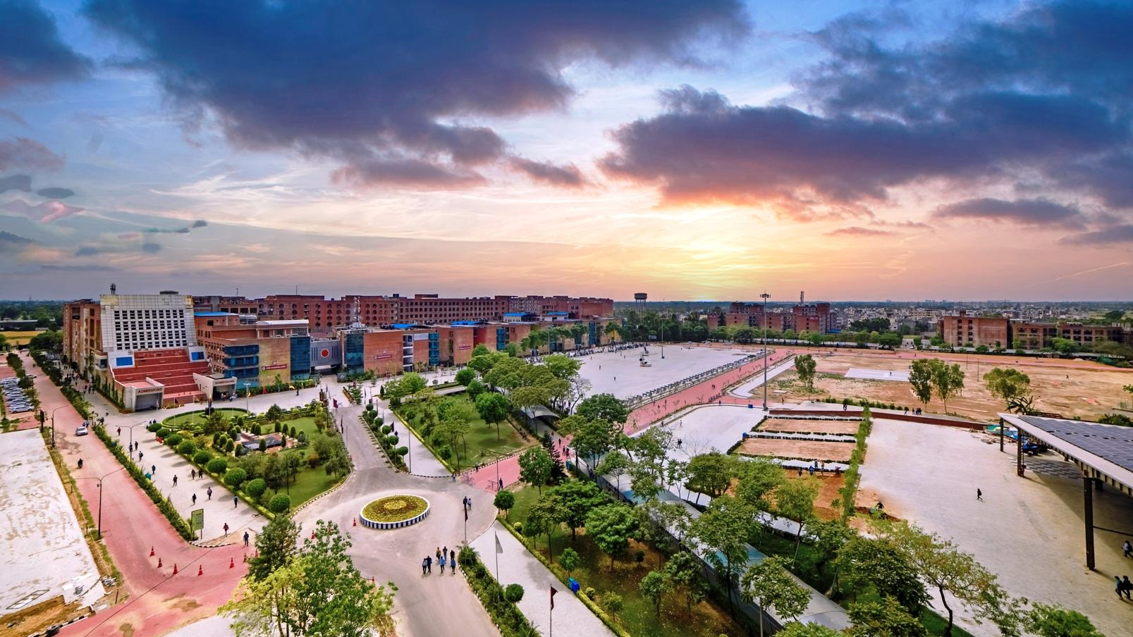
Student Support Services & Website

Slide 2

Relationship Management Cell
Helpline number +91-1824-521360
Working Hours- 9 am to 5 pm
A support team has been set up with a group of dedicated individuals who would be available to answer your queries and provide you with the best solution. You can call us Monday to Saturday between 9 am to 5 pm for any assistance. The team is entrusted with the sole responsibility of providing the right guidance to students.
Walk-in Window 32-102

Slide 3
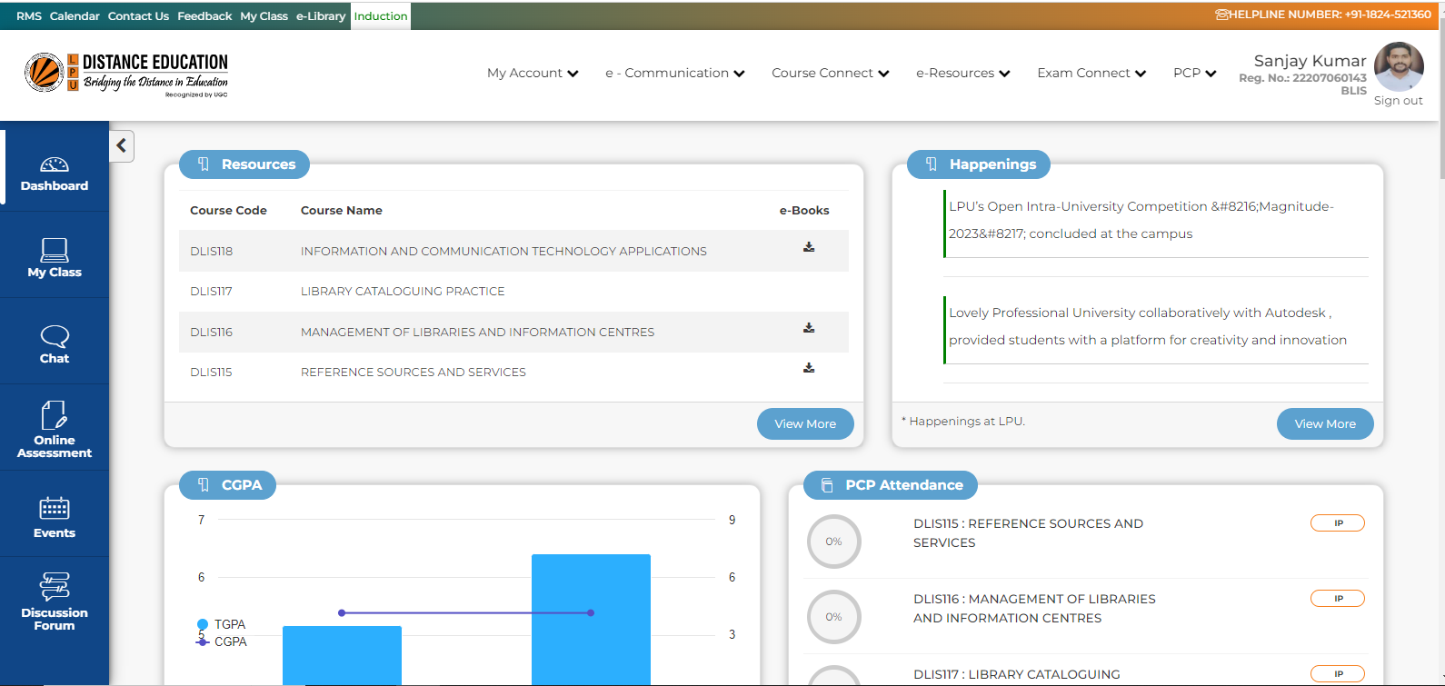
RMS Available on LPU e-Connect
Relationship Management System (RMS) is an innovative endeavour of the university that provides a platform for students to register suggestions, requests, queries, and feedback regarding various academic or administrative aspects of the university.

Slide 4
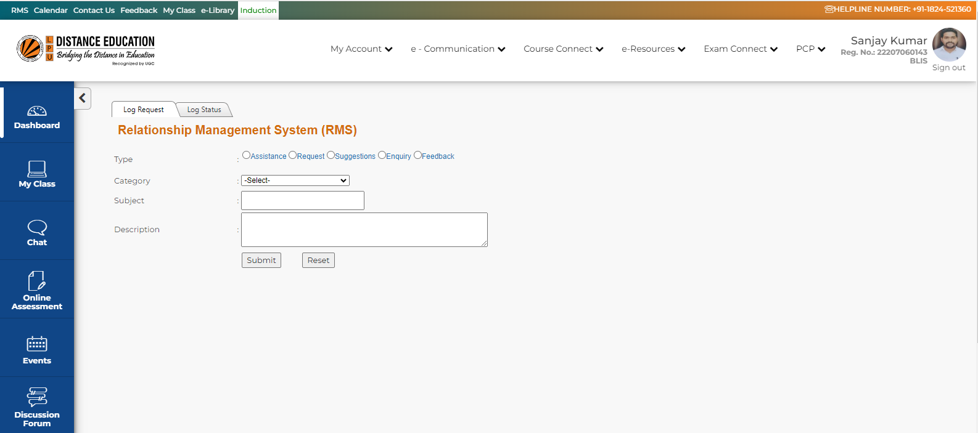
1. Log in to LPU e-Connect using your User Id and Password.
2. Select the (RMS) Tab option available on the top menu bar on the left of the Home Page.
3. Select the 'Log Request' tab.
4. Select your message type - suggestions, requests, queries, or feedback.
5. Select the desired category.
6. Enter the description of the suggestion, request, query, or feedback.

Slide 5

Professional Enhancement Programme
Aptitude Training
Soft Skills Development
Hands-on Workshops
Special classes, Workshops, Guest Lectures, Mock Interviews etc. are organized under Professional Enhancement Program (PEP) where students are trained in aptitude, reasoning, soft skills, and interviewing skills, from the course commencement until their placements.
Objective of the Professional Enhancement Programme is to enhance students’ capabilities per the career requirements, to create awareness, and motivate them to acquire add-on skills other than their subject.

Slide 6


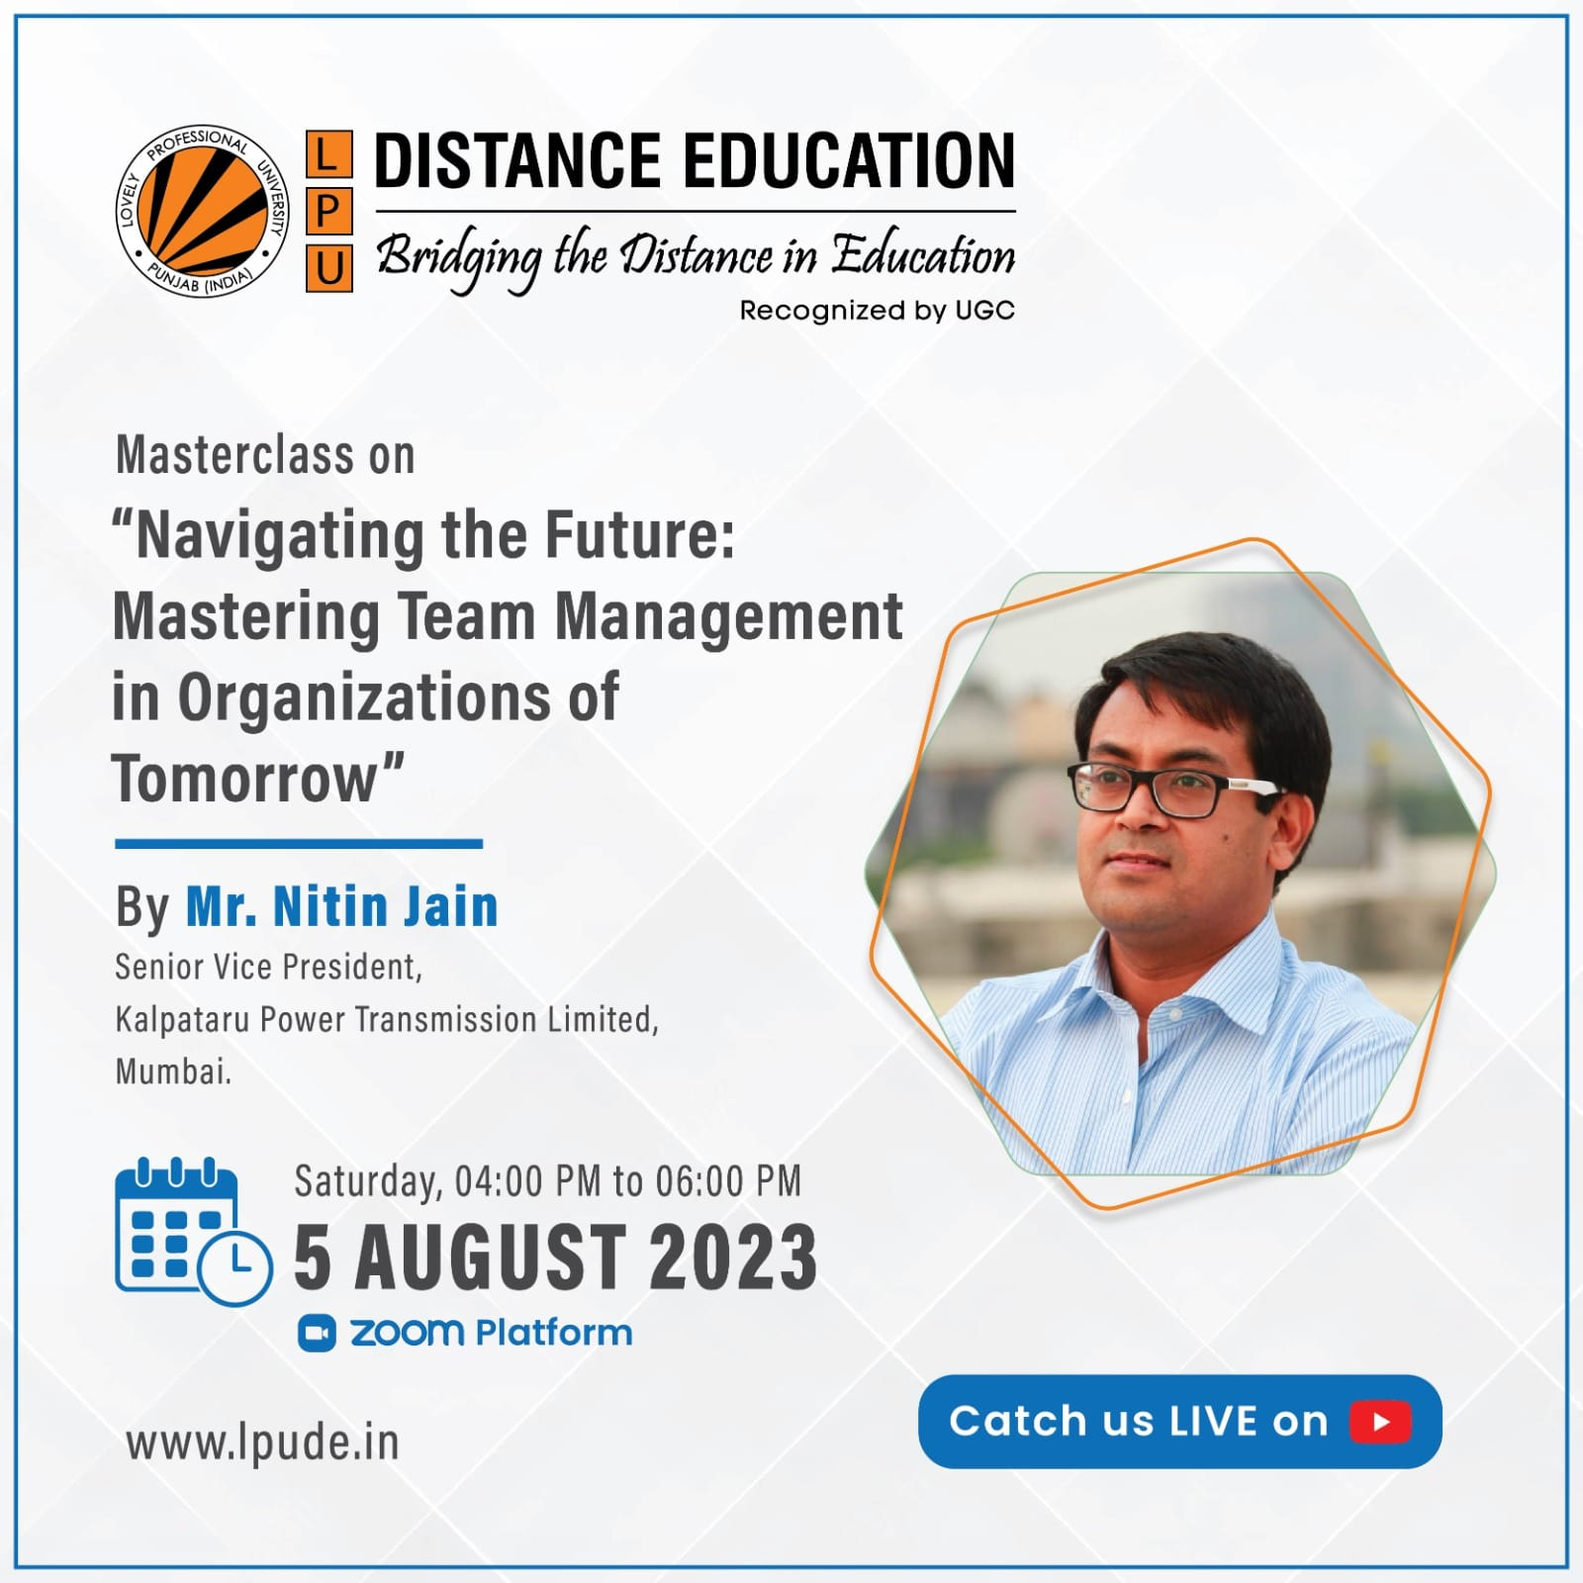
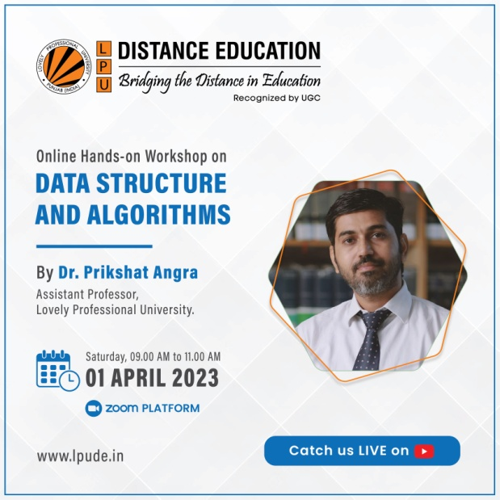
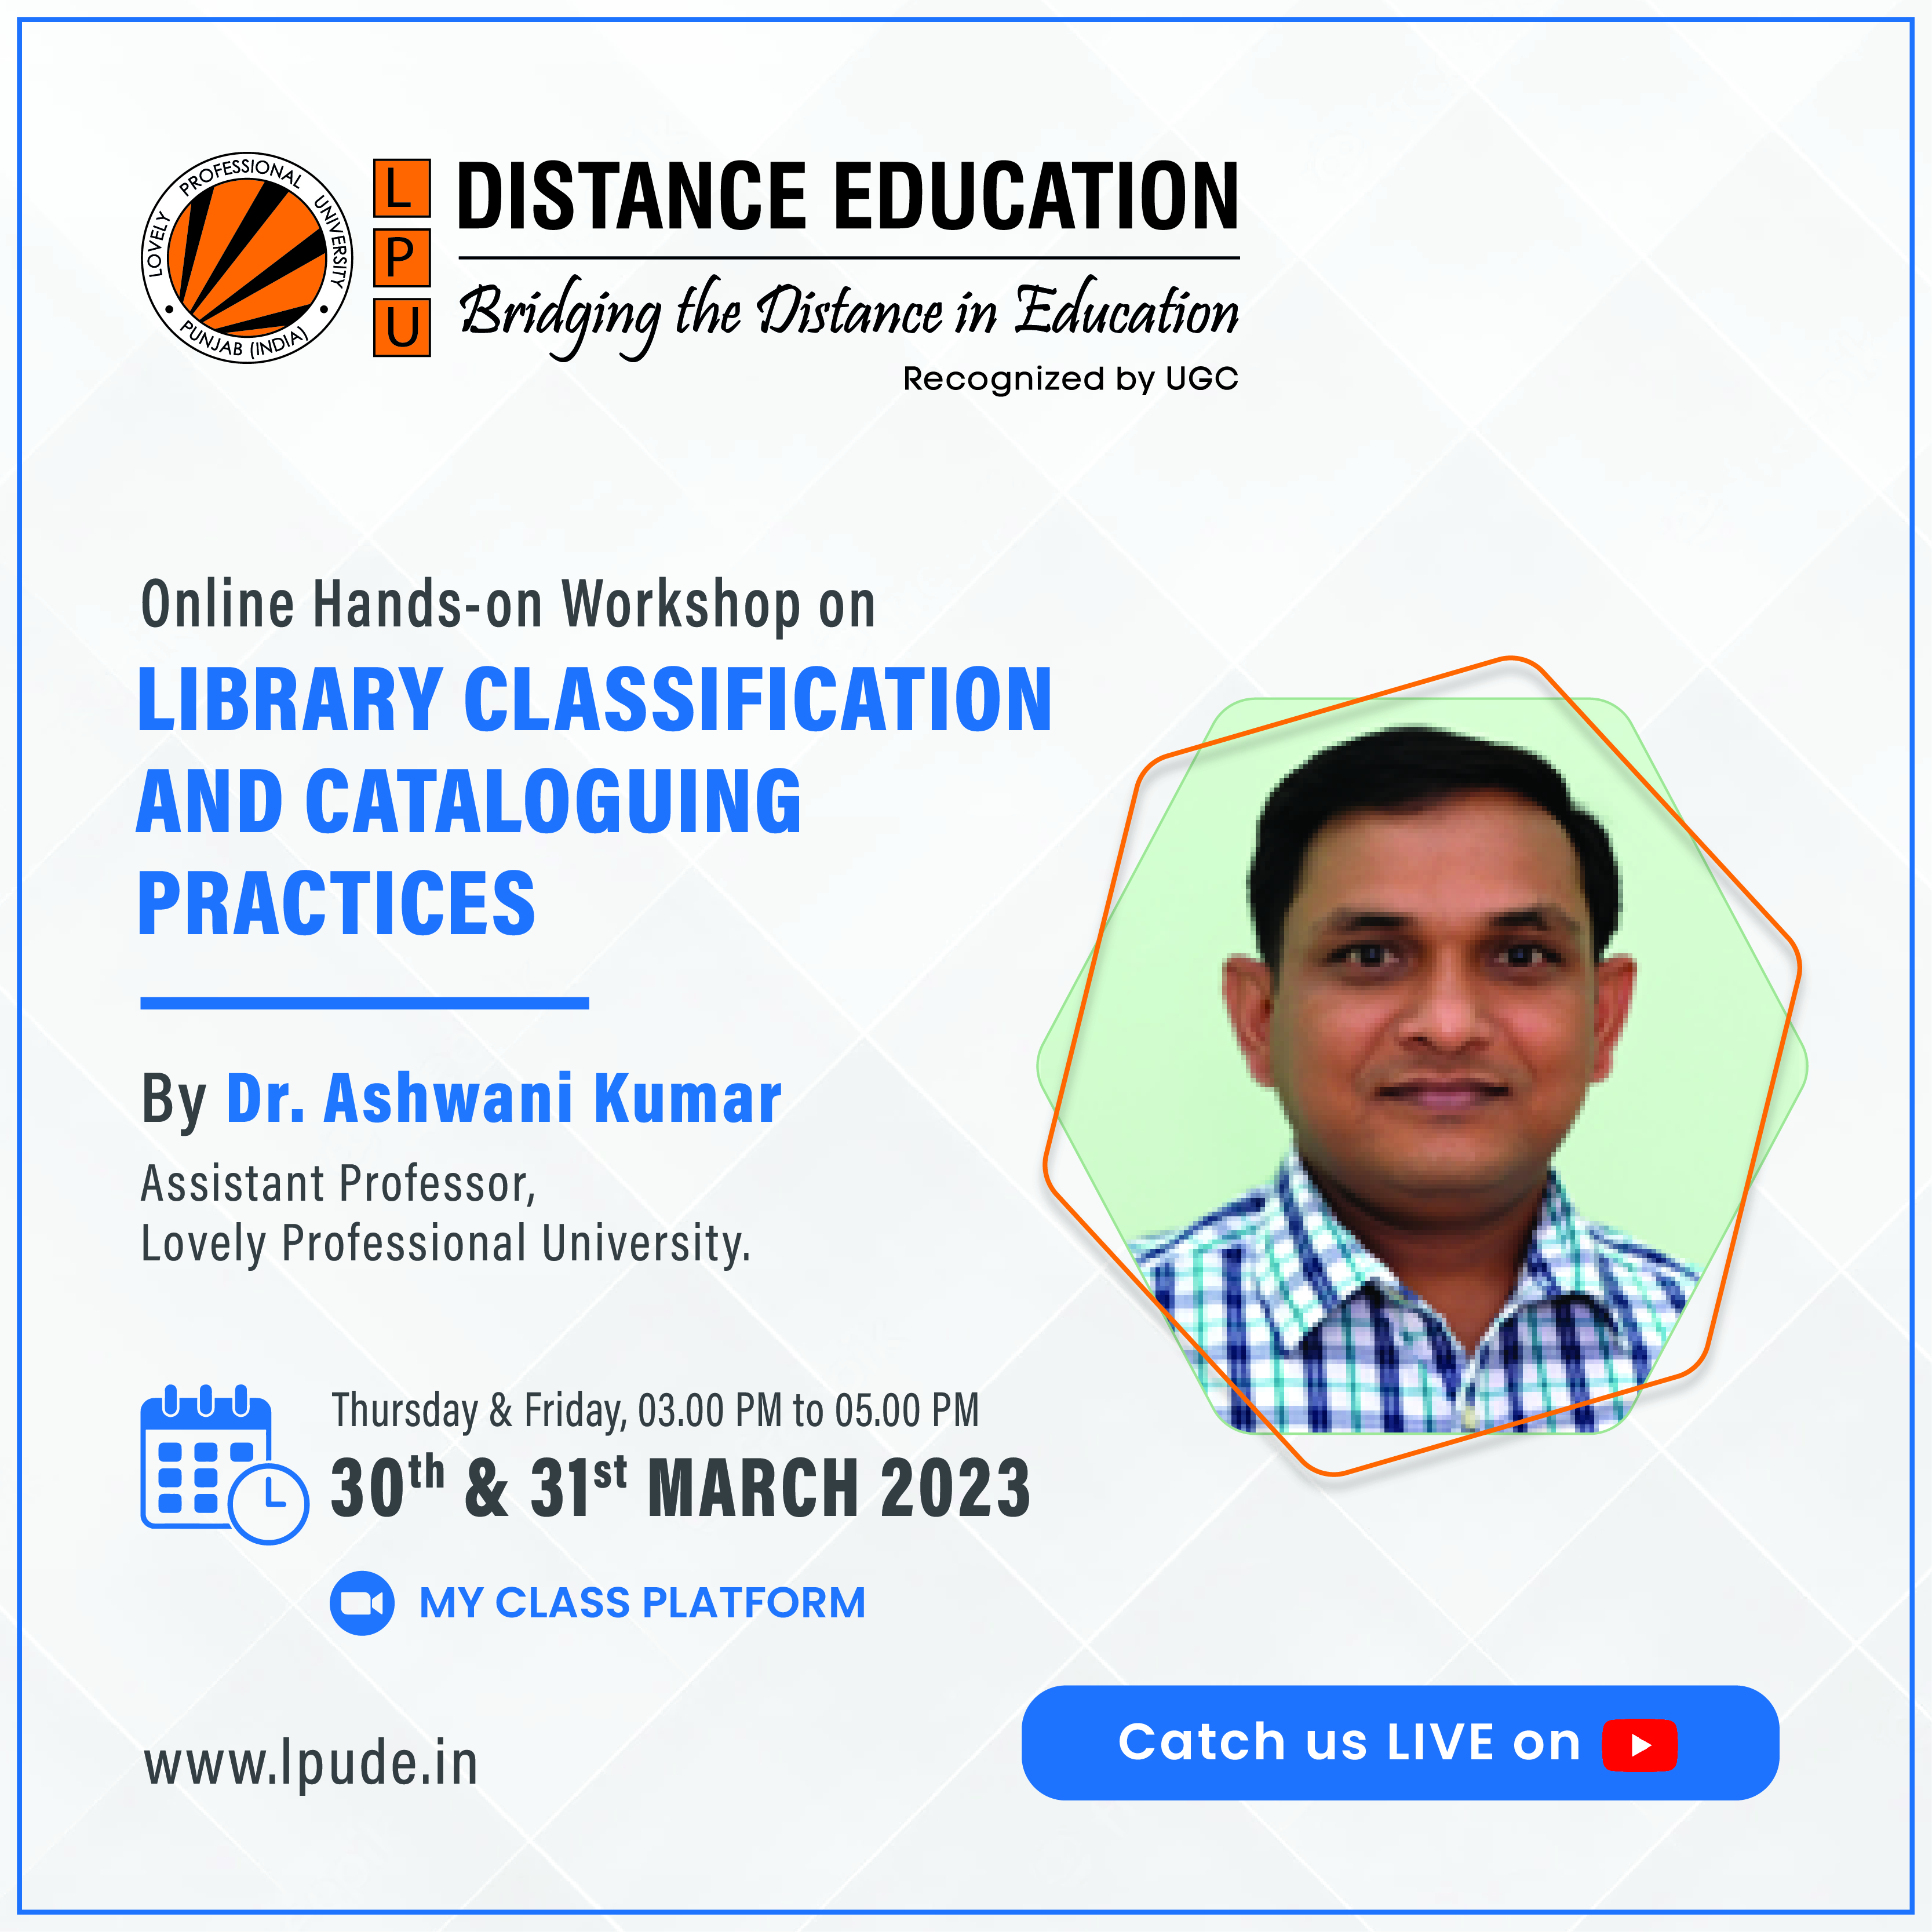
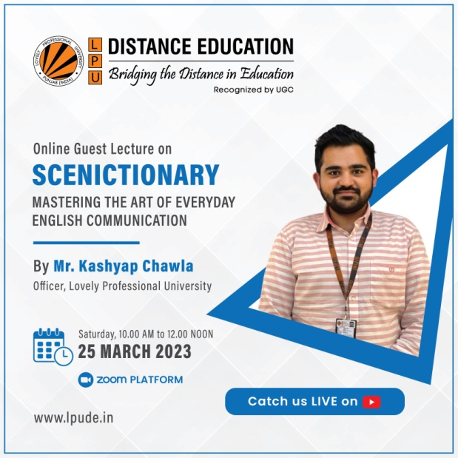
Professional Enhancement Programme

Slide 7

Placement Support
LPU provides placement opportunities to all eligible DE students with the help of the Division of Career Services.
Students are informed from time to time about various placement drives at different locations to enable them to avail the opportunities.
Students are required to register and appear in the placement drives suitable for them.
As per the requirements of certain positions, students are contacted and groomed/ guided before appearing in the applicable drives.

Slide 8
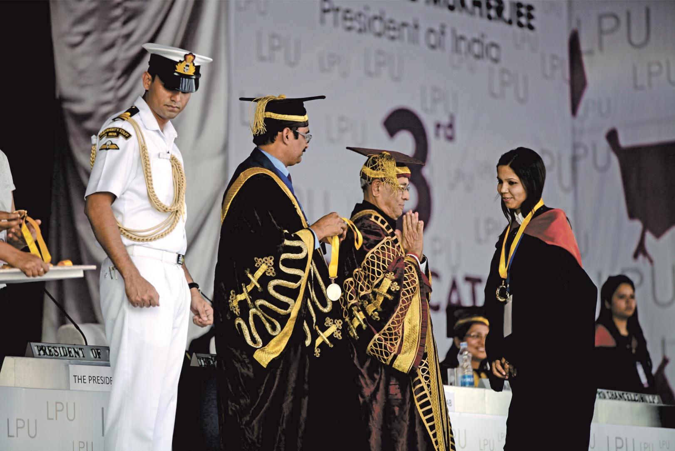
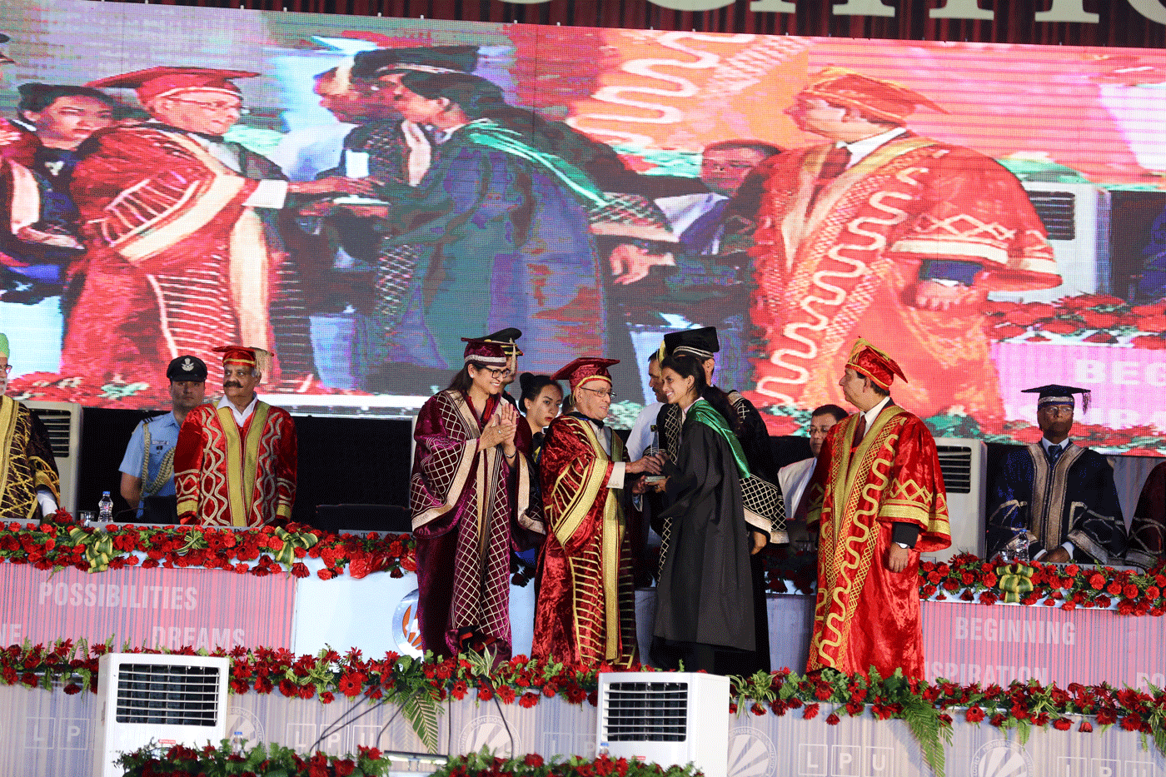
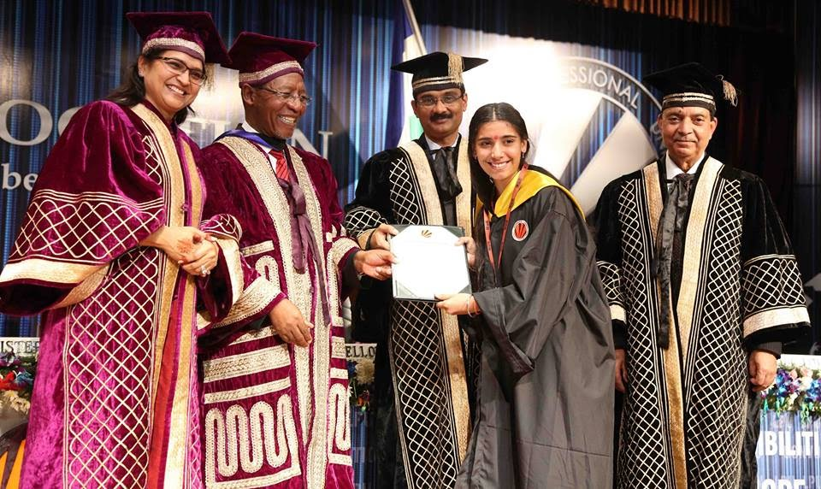
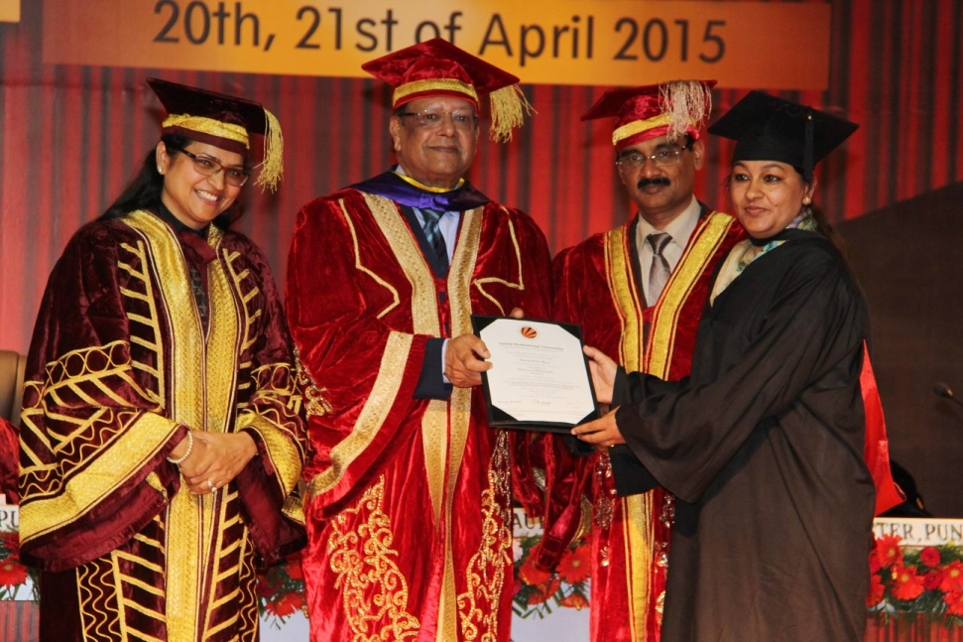
Convocation- Awarding ceremony of Degree/Diploma
LPU DE students are awarded their Degree/Diploma by esteemed dignitaries on the University campus at the convocation ceremony

Slide 9
Website- Home Page

Slide 10
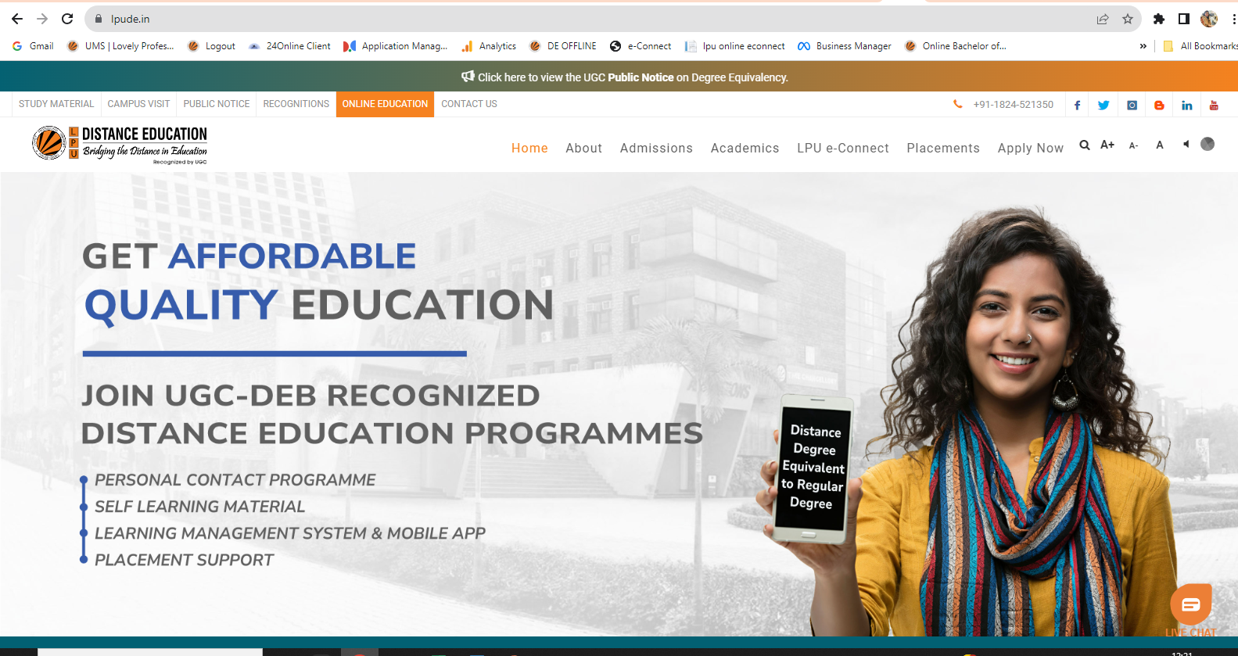

Slide 11
LPU DE website Info
Workshops/ Seminars/ Events
Programmes Details, Fee Structure, Eligibility Criteria, Admission Criteria, Duration, Scheme and Syllabus
Admission Process, Admission Forms, Admission Guidelines, and Prospectus
ID Card Verification
Personal Contact Programmes
University Contact Details
Announcements, News and Events
Recognitions
Important datesvents
FAQ
link for home page: https://www.lpude.in/

Slide 12
Social Media Links

Slide 13

Facebook
URL: https://www.facebook.com/LPUDistanceEducation/

Slide 14
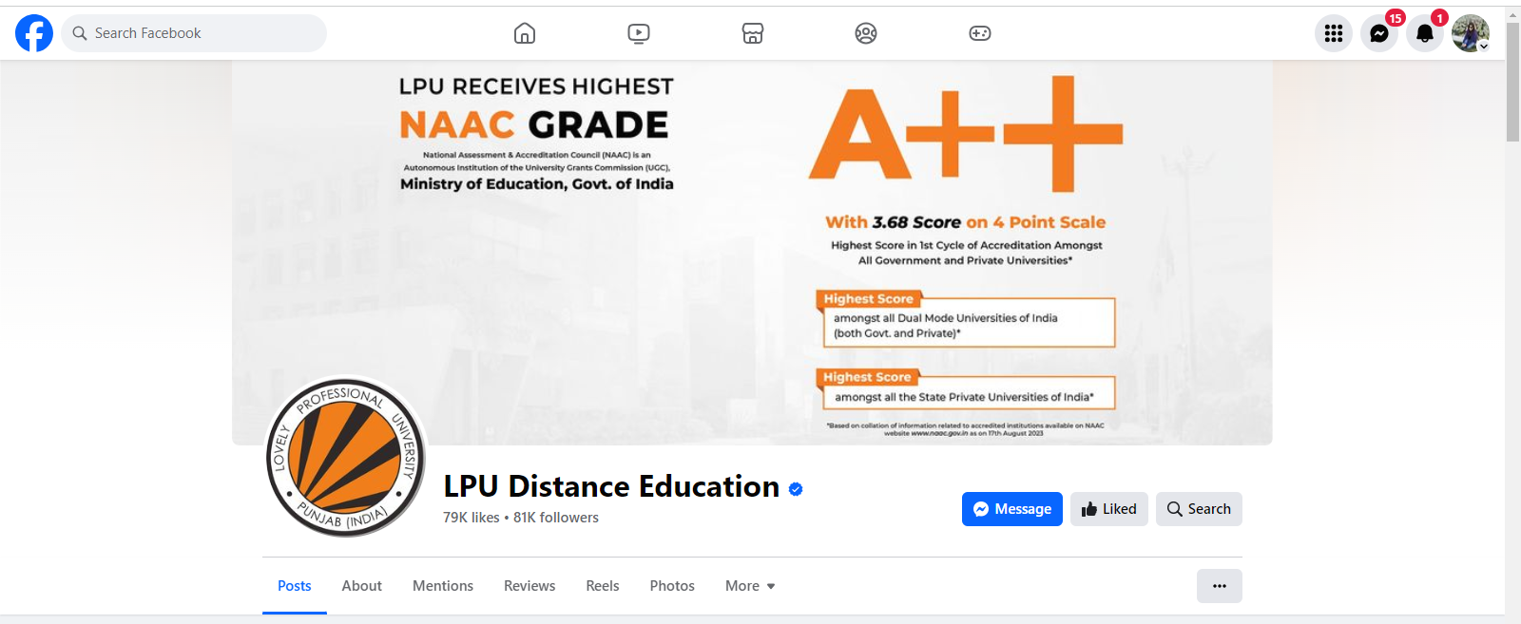
Facebook

Slide 15

Instagram
URL: https://www.instagram.com/lpudistanceeducation

Slide 16
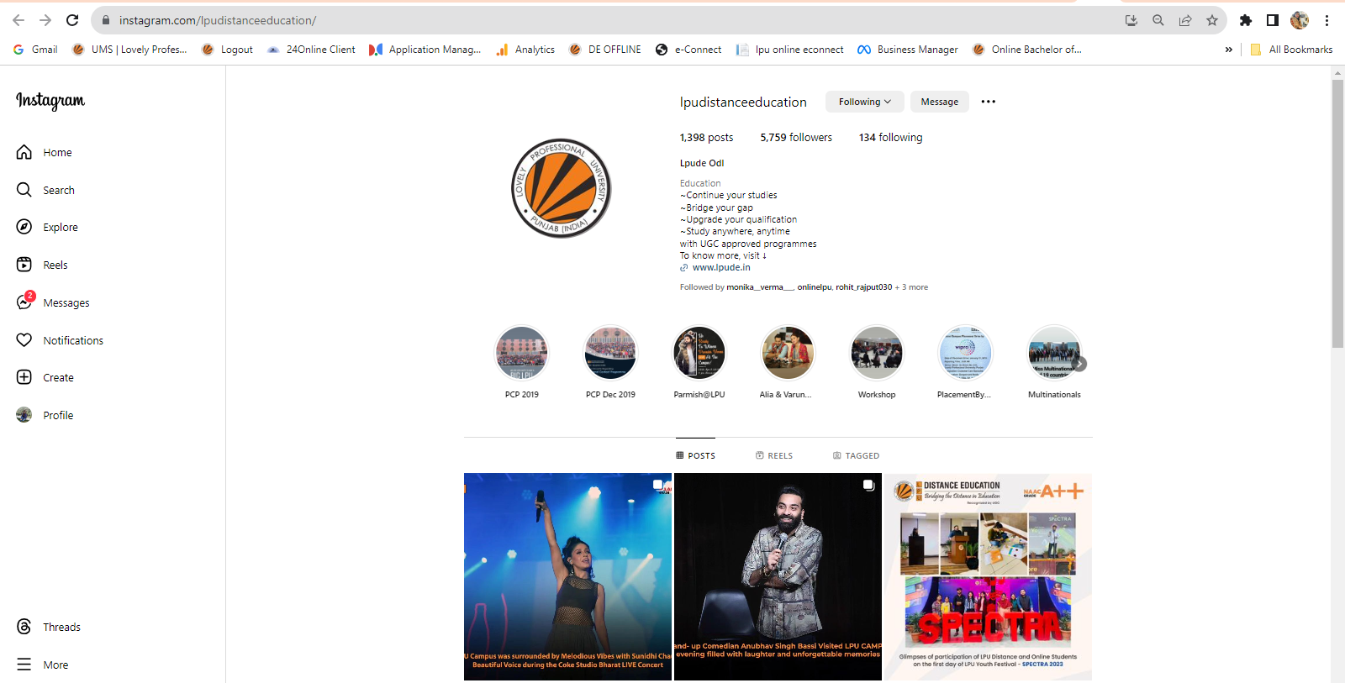
Instagram

Slide 17

LinkedIn
URL: https://in.linkedin.com/school/lpu-distance-education/

Slide 18
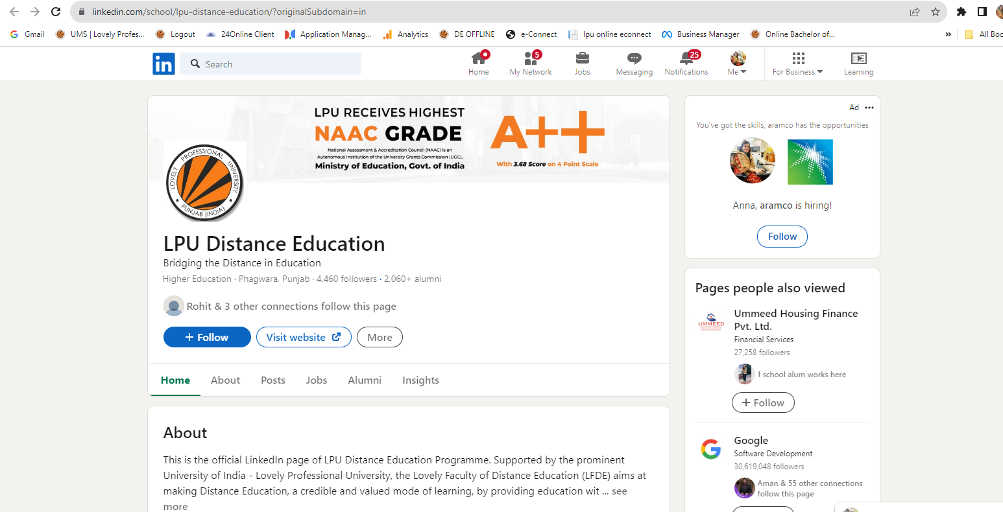
LinkedIn

Slide 19

Twitter
URL: https://twitter.com/lpudistanceedu

Slide 20
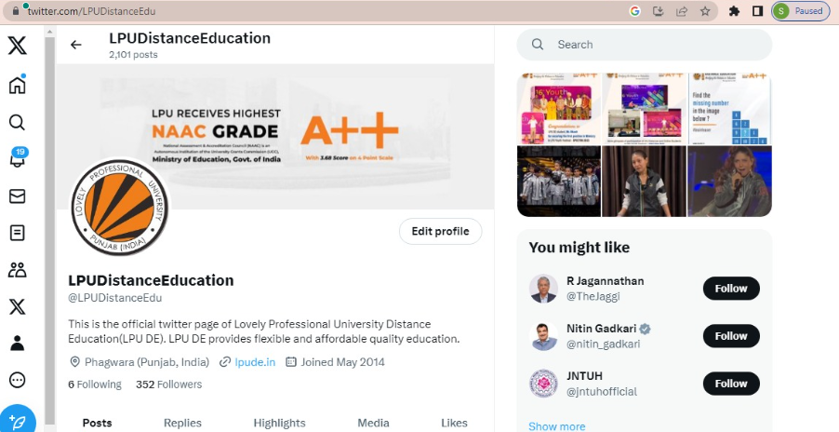
Twitter

Slide 21

YouTube
URL: https://www.youtube.com/c/LPUDistanceEdu

Slide 22
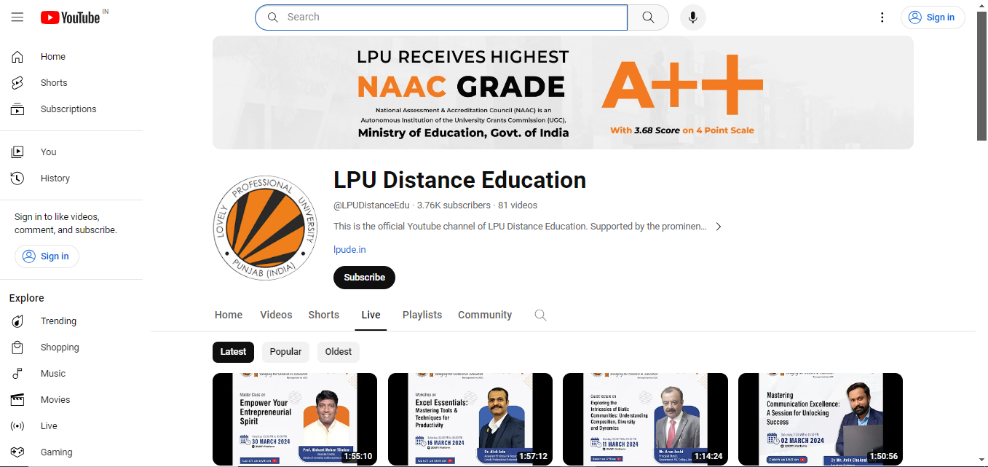
YouTube

Slide 23
Thank you

